Slide 1

project
Employee
Payroll system
Muhammad Ilyas khan
L1f23bsai0008
25-Wednesday
June/2025

Slide 2

Problem statement
Manual HR & Payroll Processes Are Inefficient and Error-Prone
Many organizations still rely on spreadsheets, paper records, or disconnected systems to manage:
Employee attendance and leaves
Payroll calculation and salary slips
Hiring and employee records
Loans, advances, and deductions
HR reporting and compliance
These outdated methods result in:
Time-consuming manual work
High chances of human error
Lack of transparency and real-time data
Difficulty scaling with company growth

Slide 3
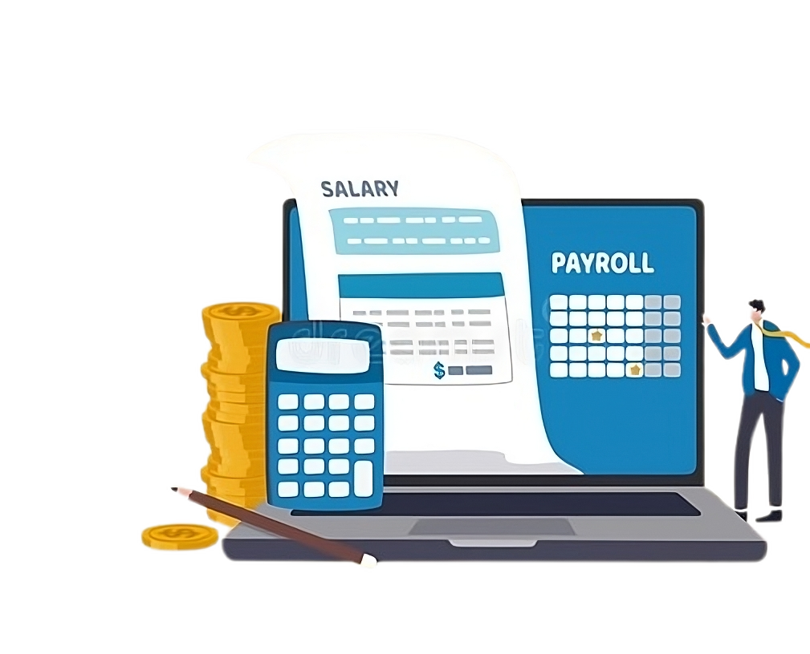
solution
All-in-One Digital Employee Payroll System
We propose a comprehensive digital system that:
✅ Tracks Attendance & Leaves: Automated check-in/check-out, leave applications, approvals
✅ Manages Payroll Seamlessly: Generates salary based on attendance, deductions, bonuses, and taxes
✅ Handles Hiring & Employee Records: Digitally stores employee profiles, hiring workflow, and contract data
✅ Tracks Loans and Advances: Manage loan requests, EMIs, and track repayments
✅ Generates Reports & Payslips: Create monthly/yearly reports, downloadable payslips, and exportable files
✅ Admin & Employee Portals: Secure role-based access with user-friendly dashboards

Slide 4

Objective
The objective of this project is to develop a fully functional and efficient Employee Payroll Management System that automates the core HR and payroll operations of an organization. This system is designed to handle key functionalities such as employee registration, attendance tracking, leave and loan management, payroll calculation, payslip generation, and comprehensive report creation. By shifting from manual processes to a digital solution, the goal is to reduce human errors, save administrative time, and enhance data accuracy. The system will also incorporate secure user authentication, role-based access, and a clean graphical user interface to ensure ease of use for both administrators and HR personnel. Overall, the project aims to provide a centralized platform that improves organizational workflow, supports scalability, and ensures smooth payroll operations in a secure and efficient manner.

Slide 5
Algorithm/Concept Being Explored
The core concept behind this Employee Payroll System is modular, event-driven application architecture using Python’s Tkinter library for the graphical user interface (GUI) and MySQL for data storage. It follows a clean MVC-like structure where user actions (e.g., marking attendance, applying for leave) trigger backend operations that interact with the database. Secure password management is handled using the bcrypt hashing algorithm, ensuring robust authentication. The system supports full CRUD operations across employees, attendance, loans, leaves, and payroll. It also includes real-time reporting, automated salary calculations, and dynamic form validation, all optimized with object-oriented programming (OOP) principles for maintainability and scalability.

Slide 6
Database Operations
The system uses a MySQL database to store and manage all employee-related data securely and efficiently. All operations are performed
using structured SQL queries executed through Python’s pymysql connector. The database schema includes tables for employees, attendance,
leaves, loans, payroll, and admin users. Key operations include:
Insertions: Adding new employee records, leave requests, loan applications, and payroll entries.
Updates: Modifying existing data such as salary, contact details, leave approvals, or loan status.
Deletions: Removing records like terminated employees or completed loans.
Queries: Retrieving filtered data for reports, dashboards, and real-time UI updates.
Joins: Combining multiple tables (e.g., employee and payroll) to generate comprehensive views.
Transactions: Ensuring data consistency during critical operations like payroll processing.
These operations are wrapped in a centralized Database class to maintain connection management, error handling, and code reusability.

Slide 7


Programming Languages & Frameworks
Python
Tkinter
sql
The core programming used for building the entire application logic.
Employee for GUI, backend processing, and database interaction.
Follows OOP for modular and reusable code
Used to design the desktop-based graphical user interface (GUI).
Supports event-driven programming, making the application interactive and user-friendly. Other modules are tkcalender, datetime, os, webrowser, pymysql, bcrypt, fpdf.
Relational database used for storing employee data, payroll, attendance, loans, leaves, and admin records.
Ensures data integrity and supports complex queries and joins.

Slide 8
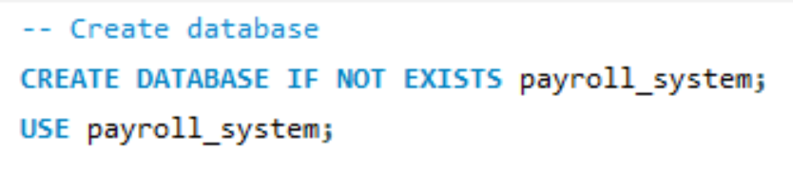
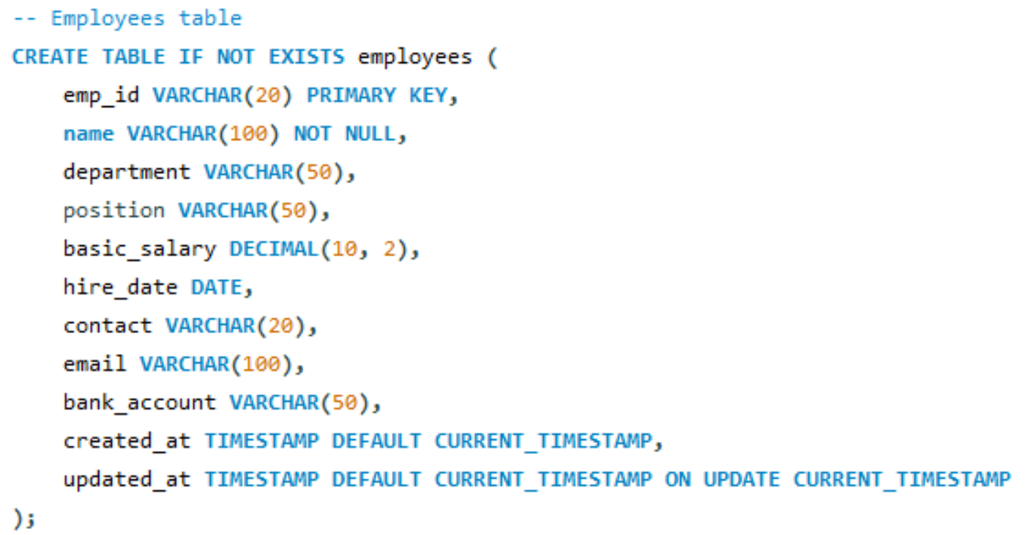
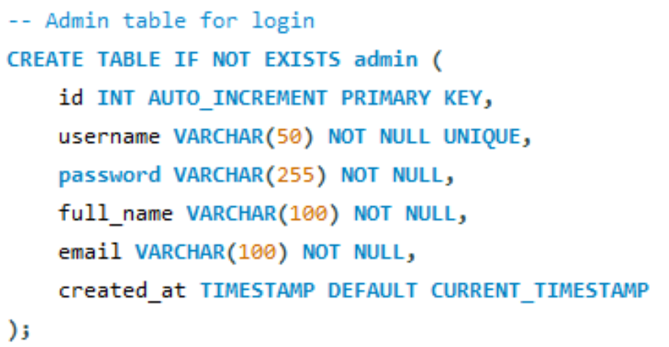
SQL Queries

Slide 9
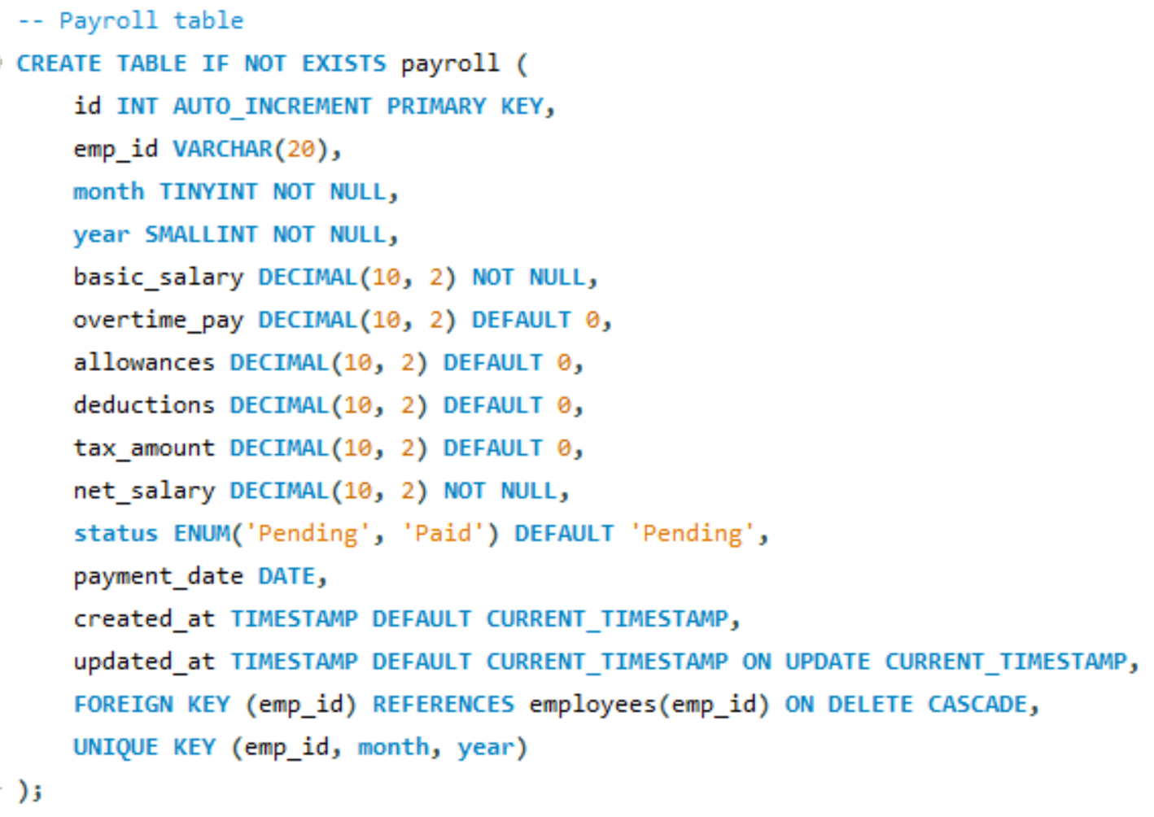
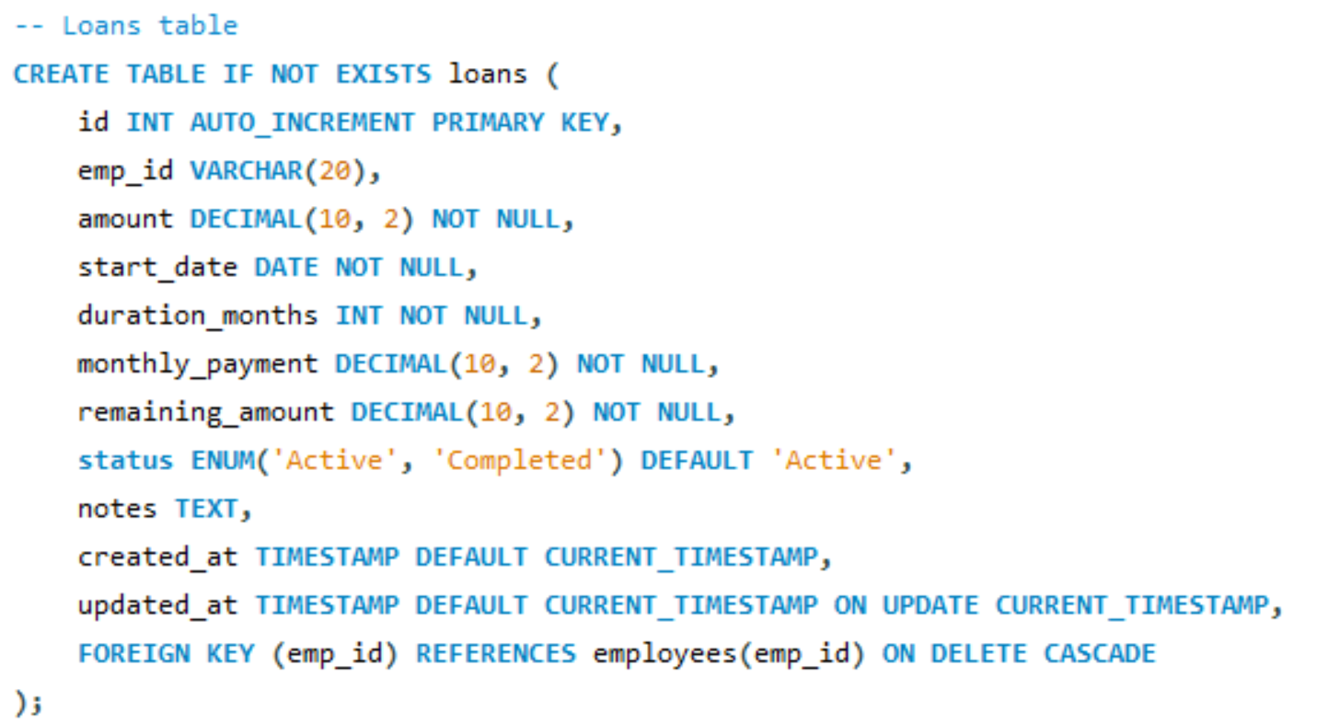
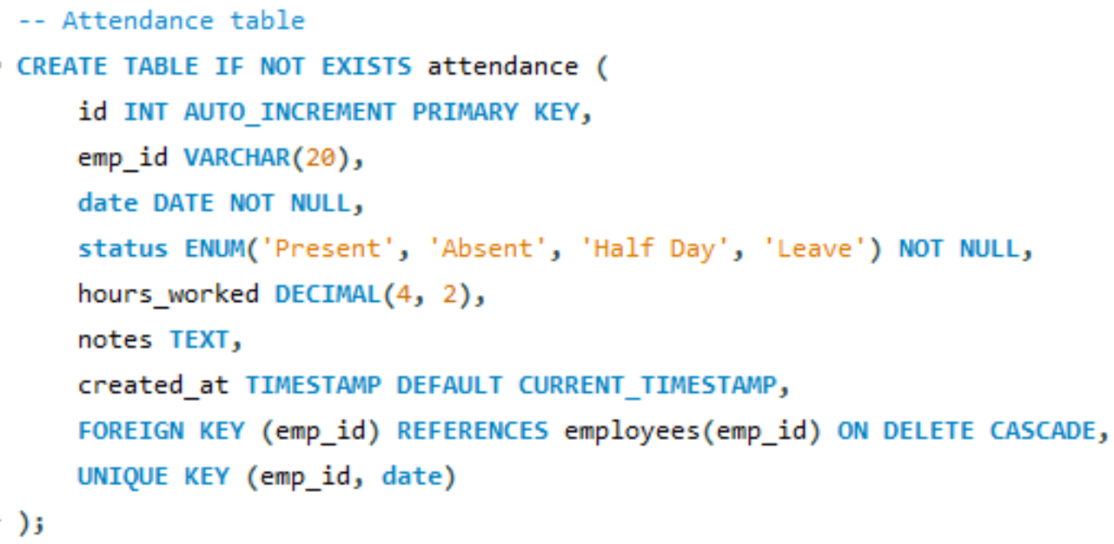
SQL Queries

Slide 10
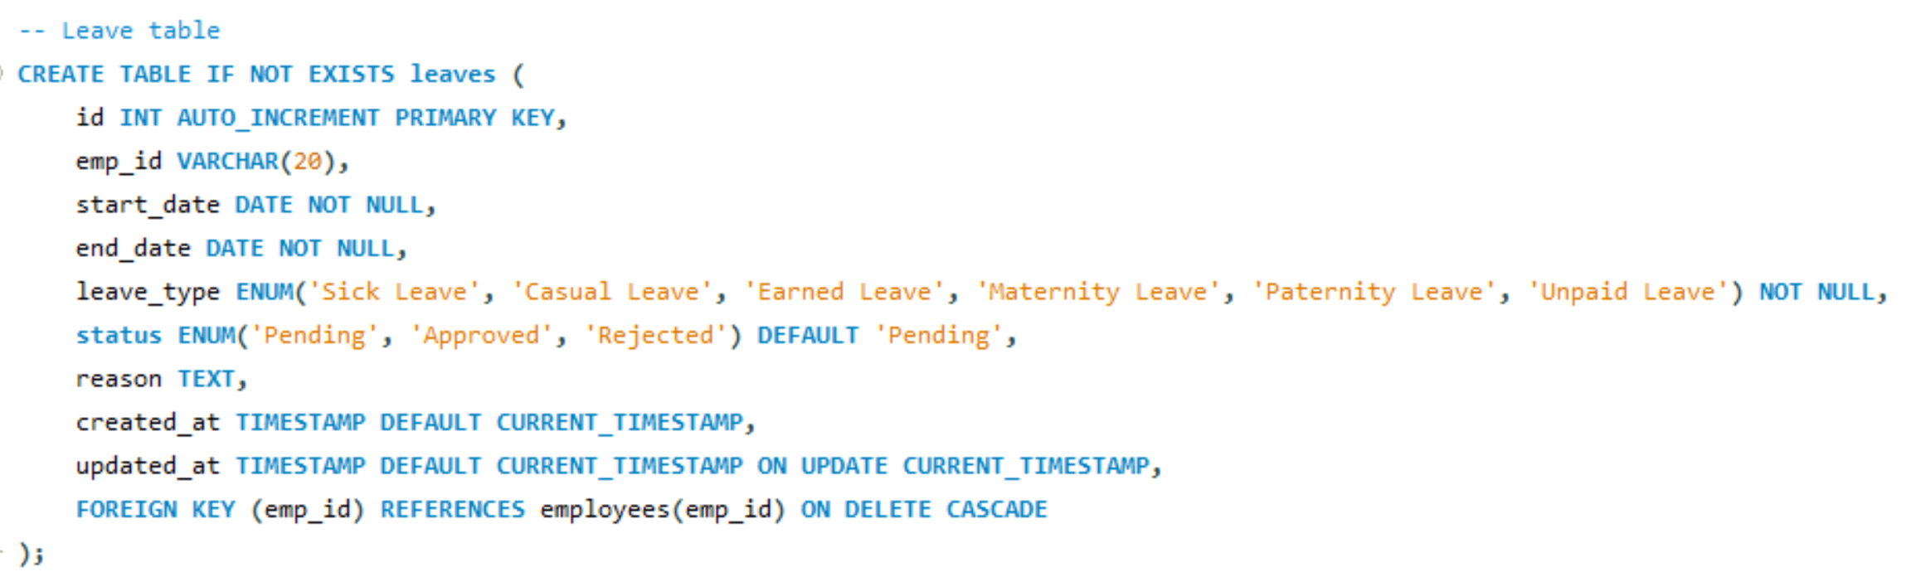
SQL Queries

Slide 11
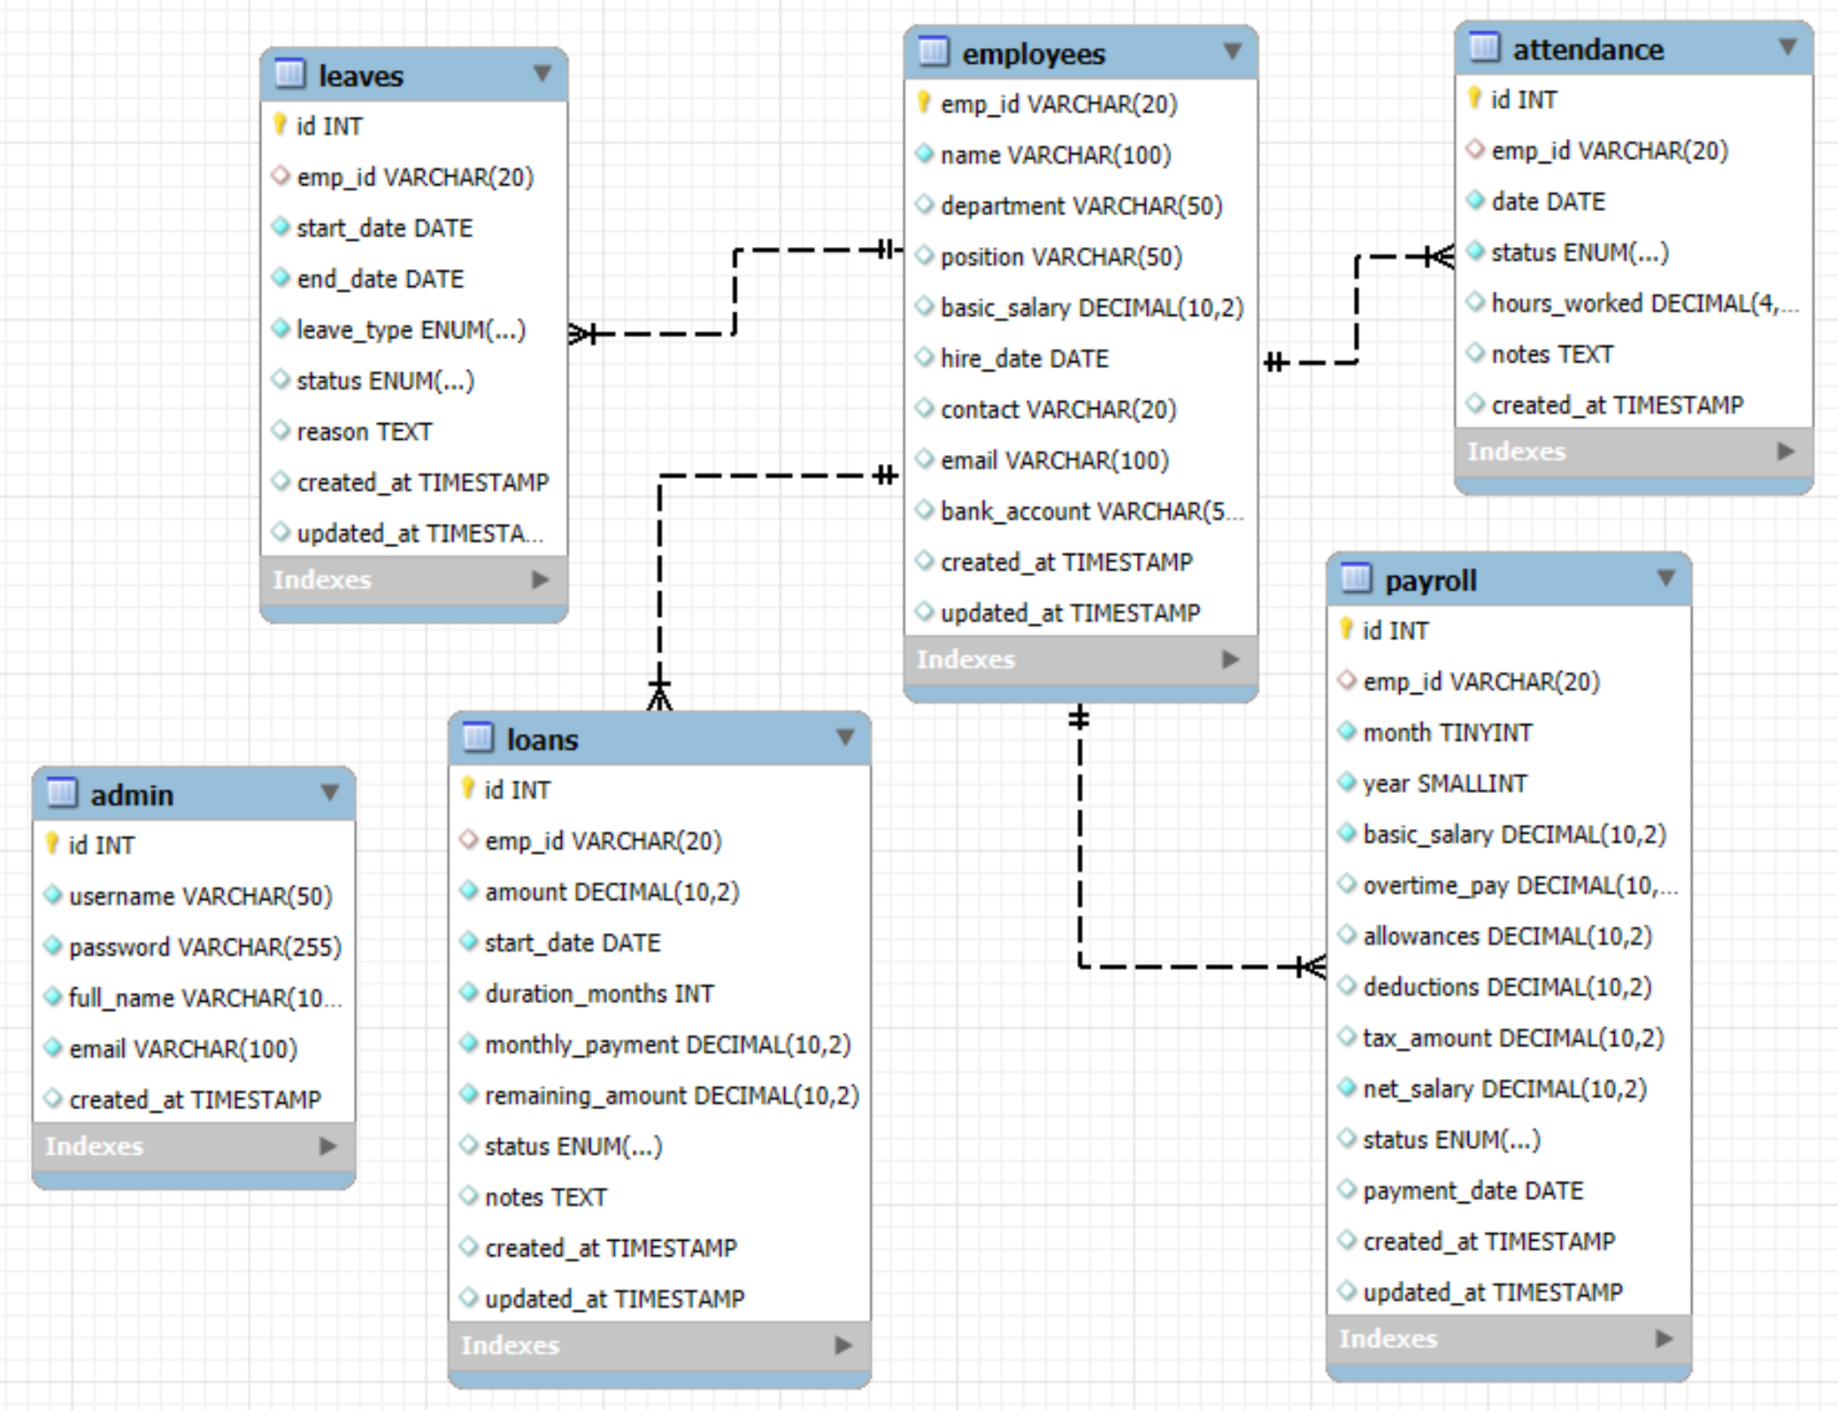
ERD DAIGRAM

Slide 12
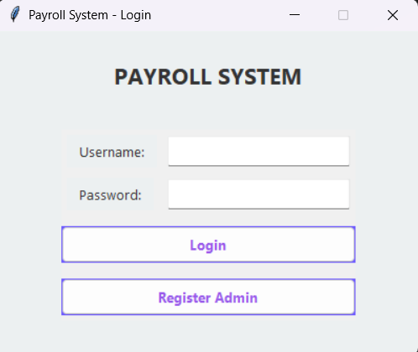
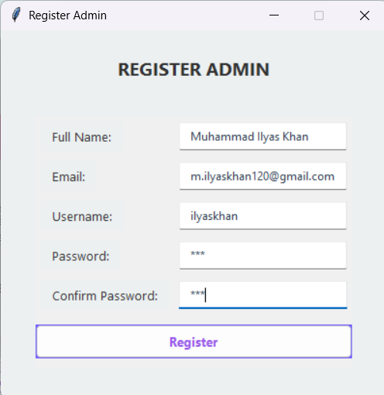
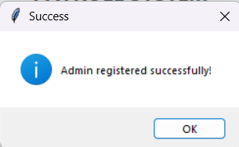
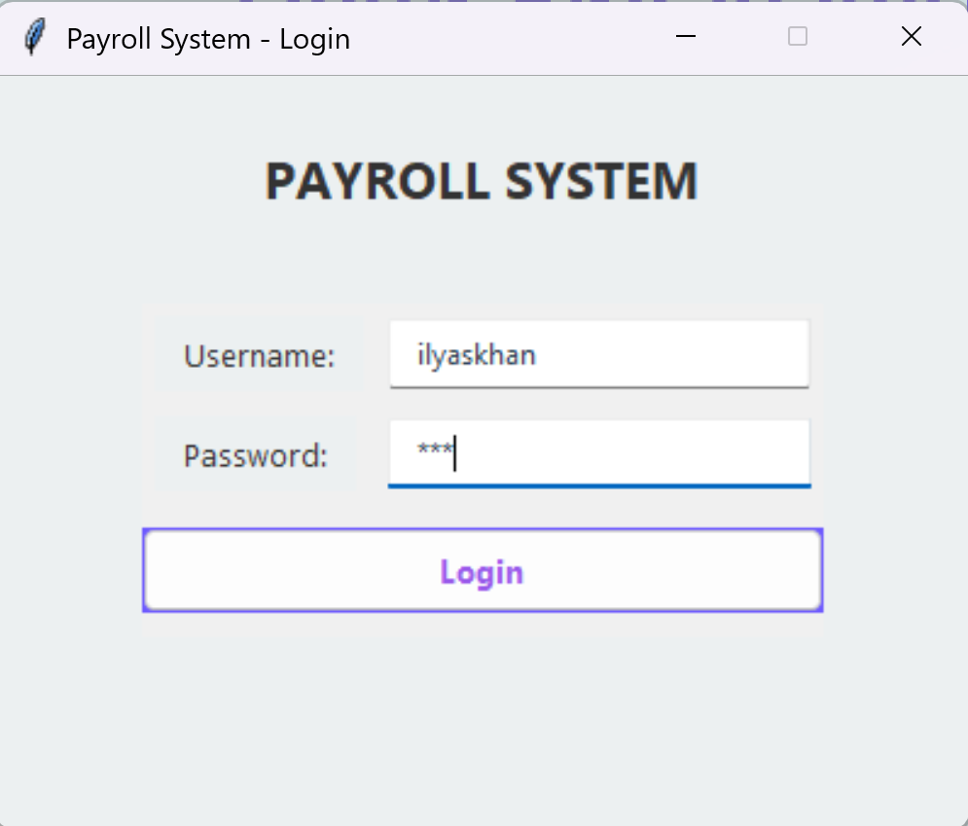
Login and Register
1.
2.
3.
First, run the app, then click
on "Register Admin" to open the registration form.
Enter your details (name, email, username, password, confirm password) and click on "Register."
You’ll see a popup saying "Admin registered successfully" — now enter your username and password on the login screen and click "Login."

Slide 13
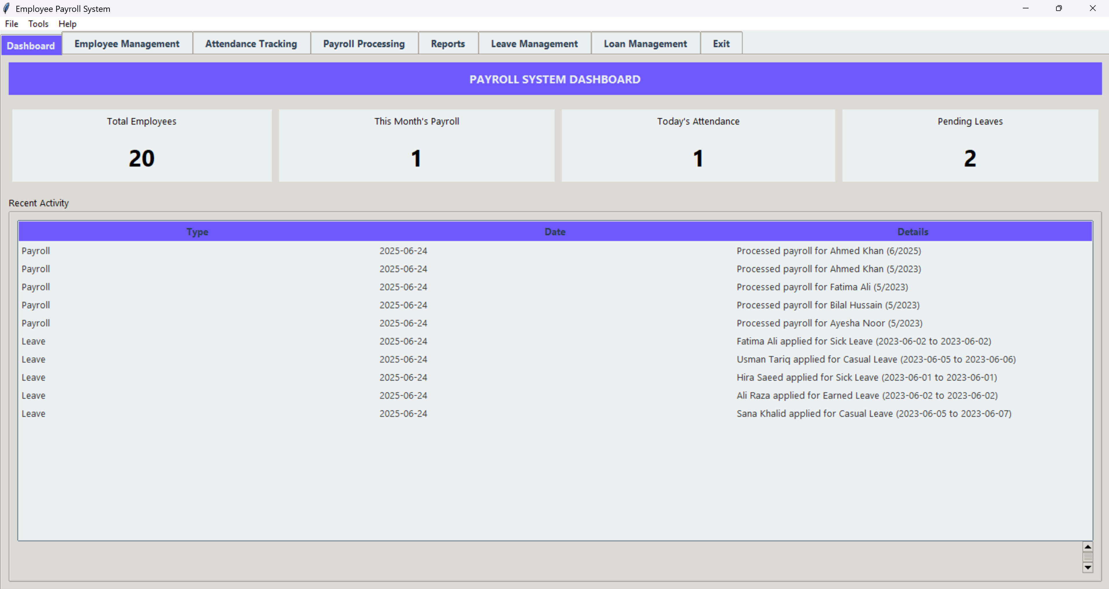
Dashboard

Slide 14
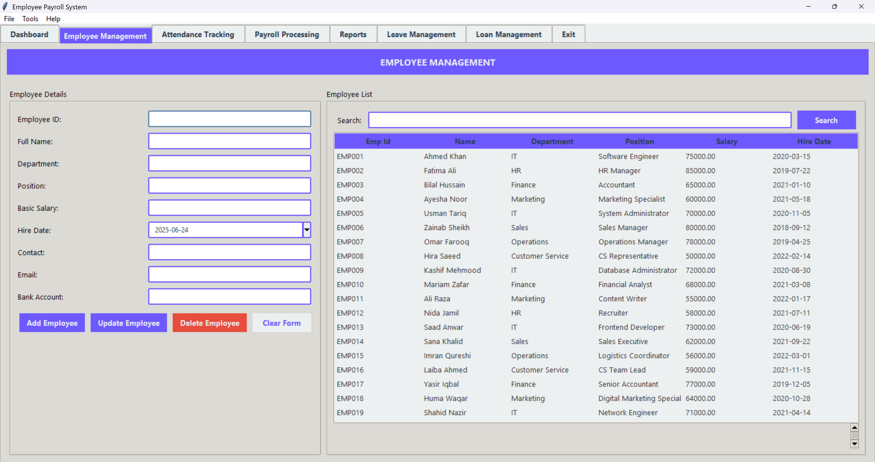
Employee Management Dashboard

Slide 15
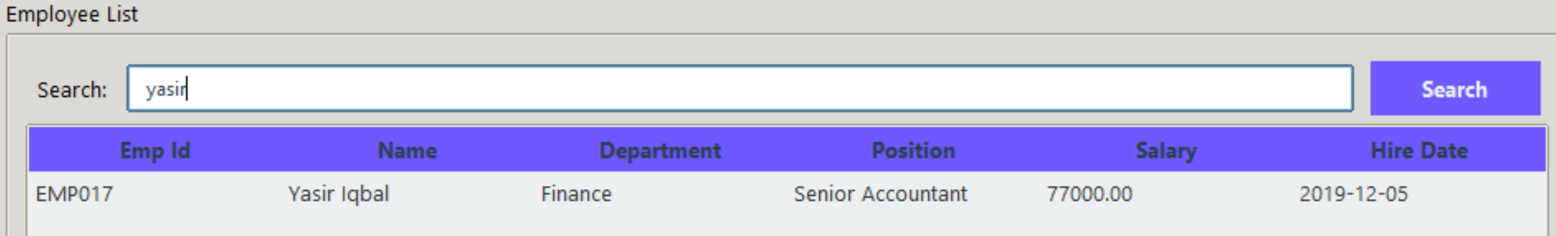
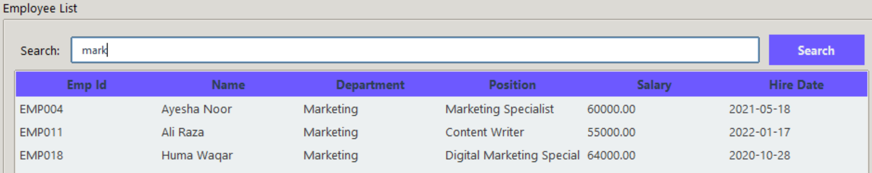
Search Employee
You can search employee by his/her name, simply write his/her name in the search box and it will automatically search that employee if exist.
Or you can search employee by his/her Position, Department or Hiring date, simply write in the search box and it will automatically search that employees if exist.

Slide 16
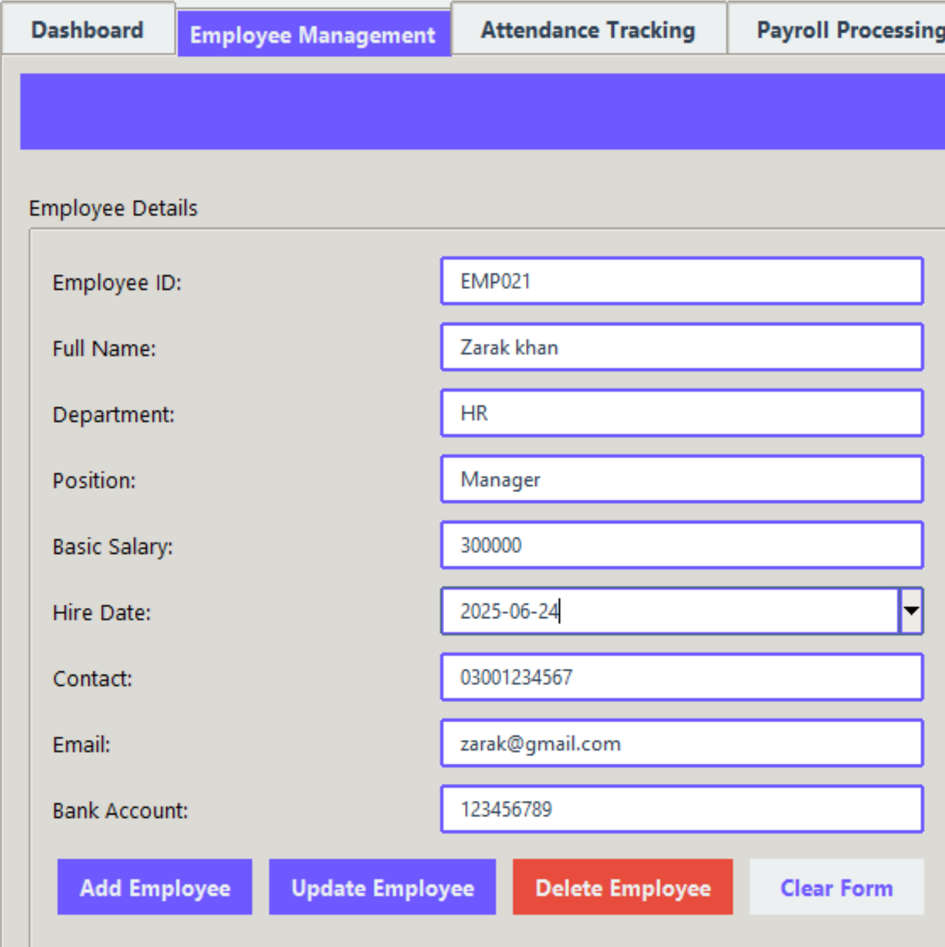
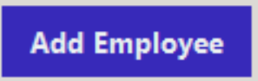
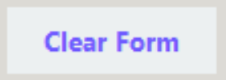
Adding Employee
Go to the "Employee Management" tab in the app.
Enter the employee’s details (ID, name, department, position, salary, etc.) in the form.
Click on the "Add Employee" button — the employee will be added and will appear in the list below or through the search bar.
To clear the form, simply click the "Clear Form" button in the Employee Management tab. This will instantly reset all input fields, allowing you to enter fresh employee data without manually deleting previous entries.

Slide 17
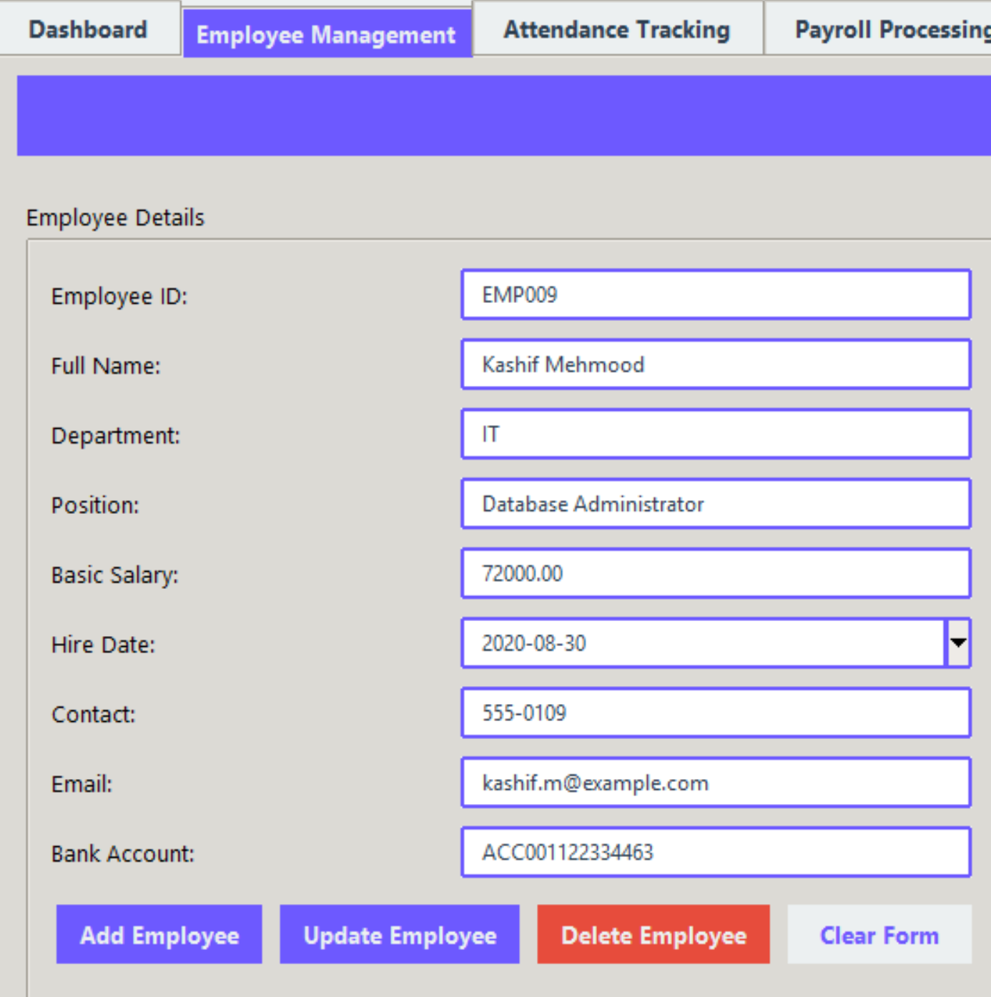
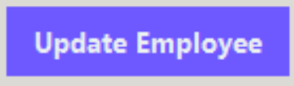
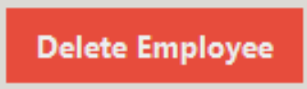
Delete or Update Employee
Select the employee from the table — their data will automatically fill the form fields.
Make the necessary edits, then click the "Update Employee" button to save the changes.
Select the employee from the table whose record you want to remove, then click the "Delete Employee" button.
A confirmation will appear, and upon approval, the employee will be permanently removed from the system.

Slide 18
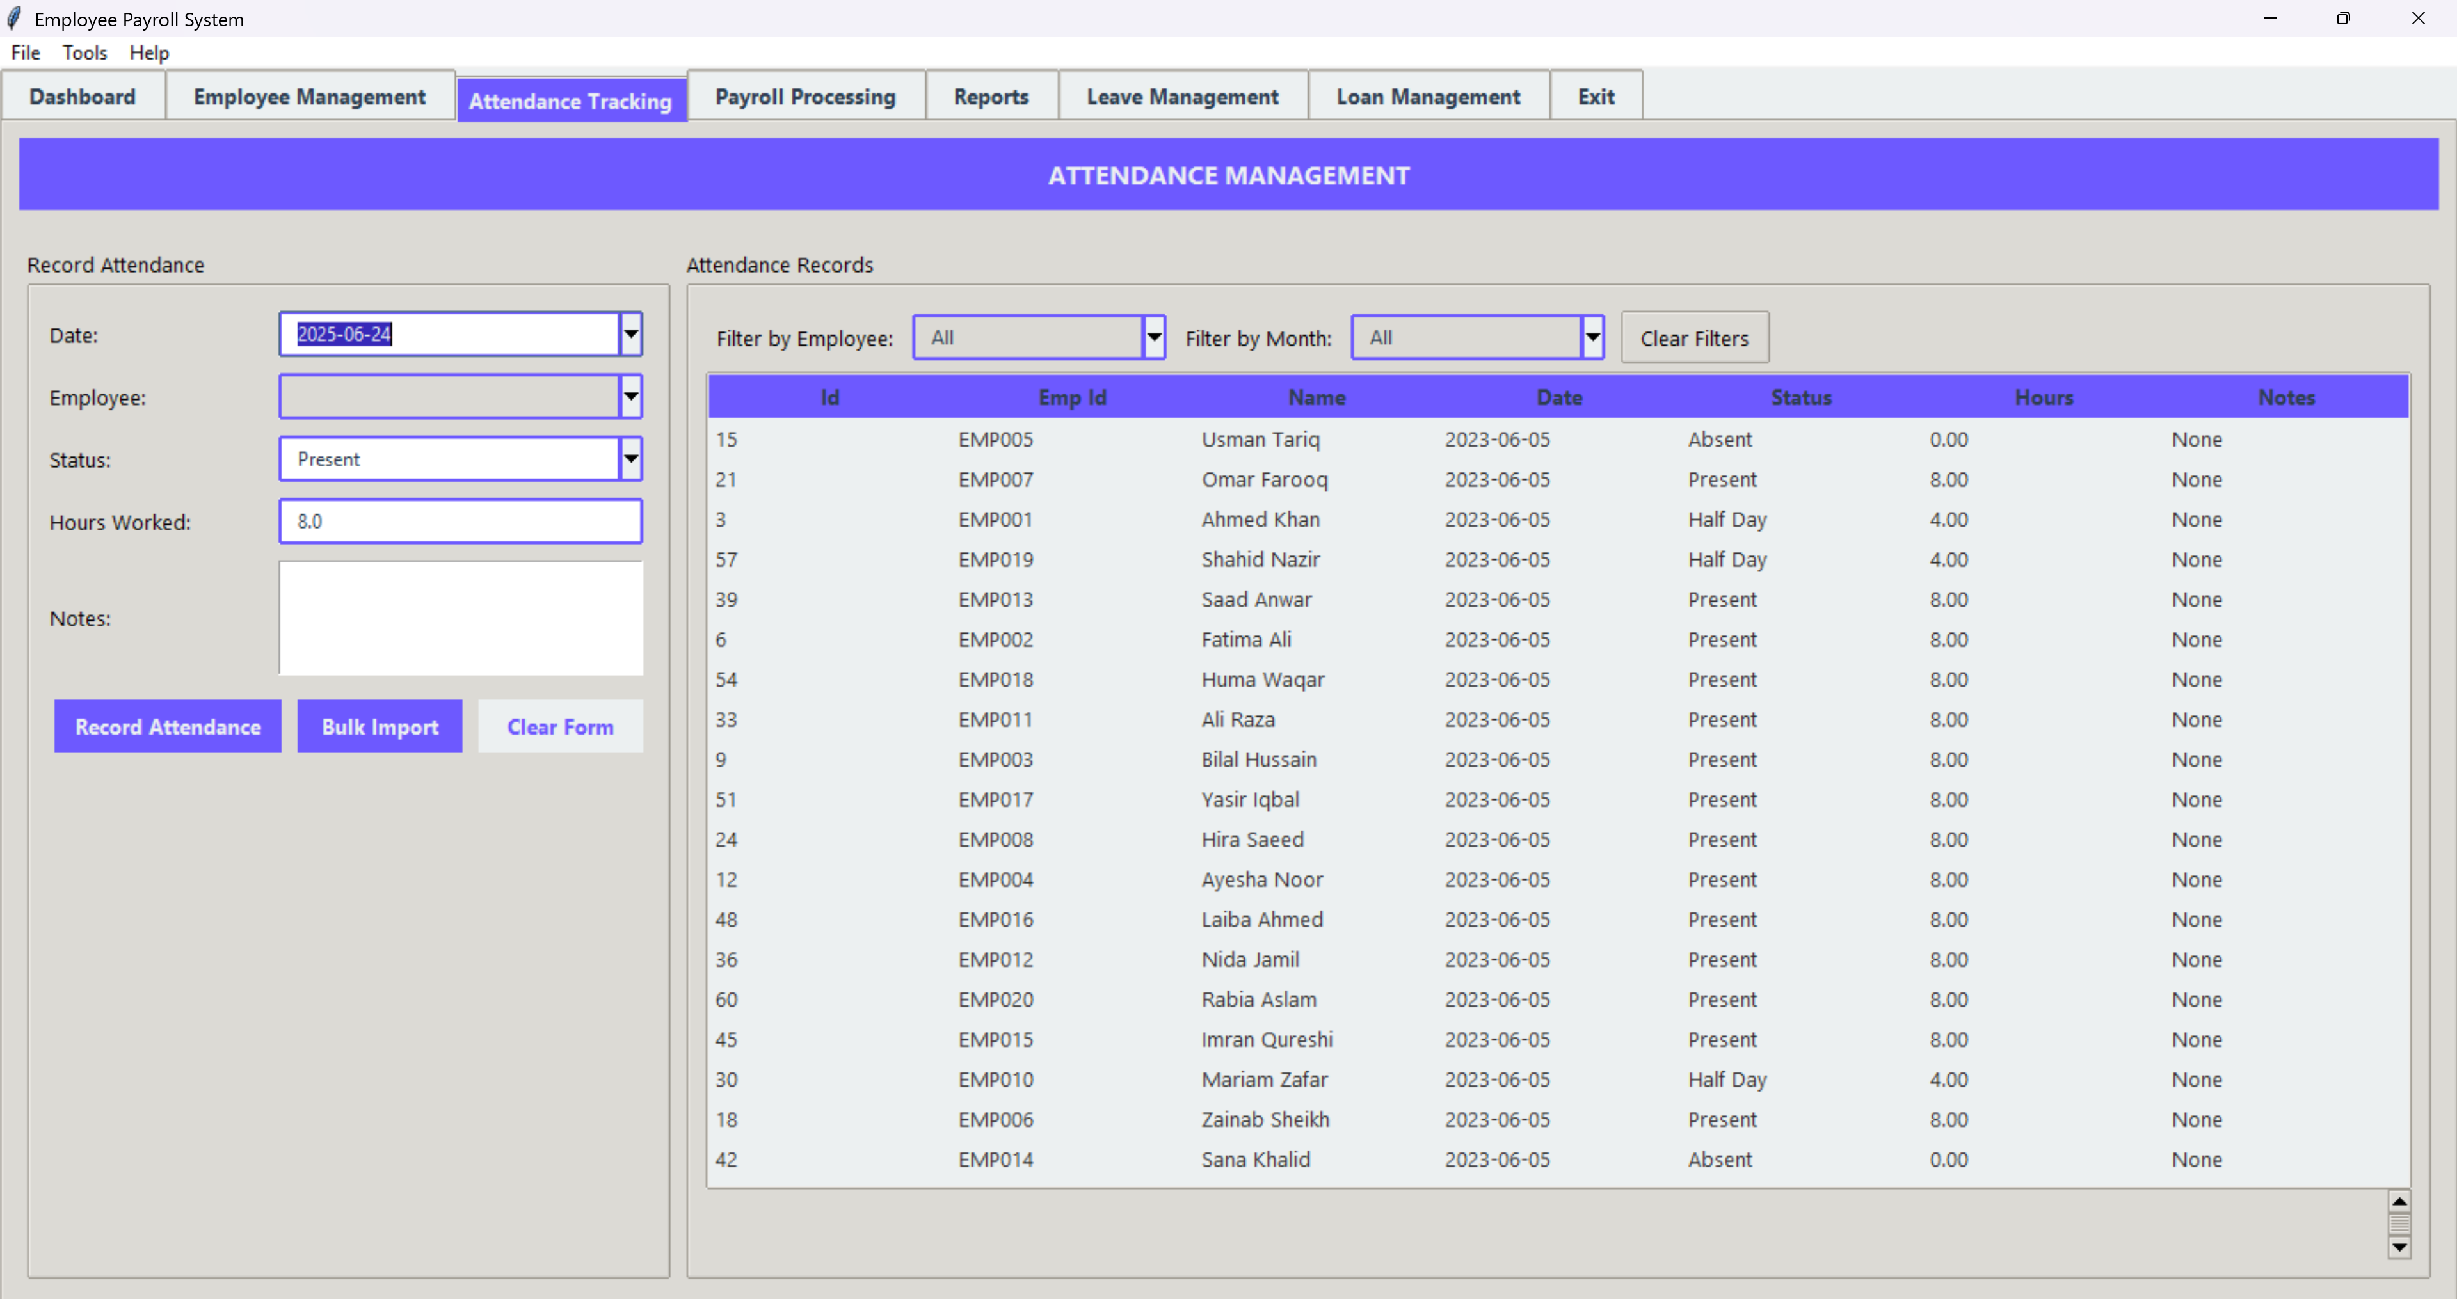
Employee Attendance Dashboard

Slide 19
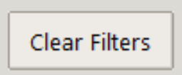
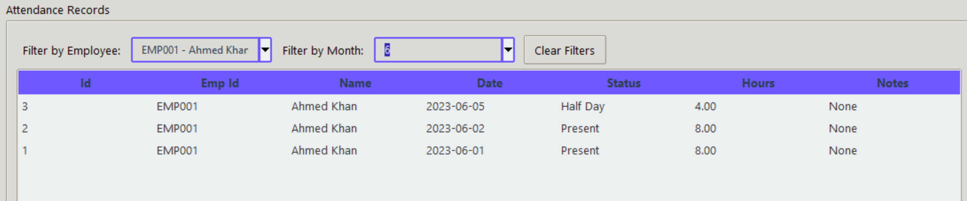
Search Employee Attendance
To search Employee Attendance, simply filter by employee name and month it automatically fetch all his/his data in that month.
To clear the filter simply click on Clear Filters and all the record will be shown again.

Slide 20
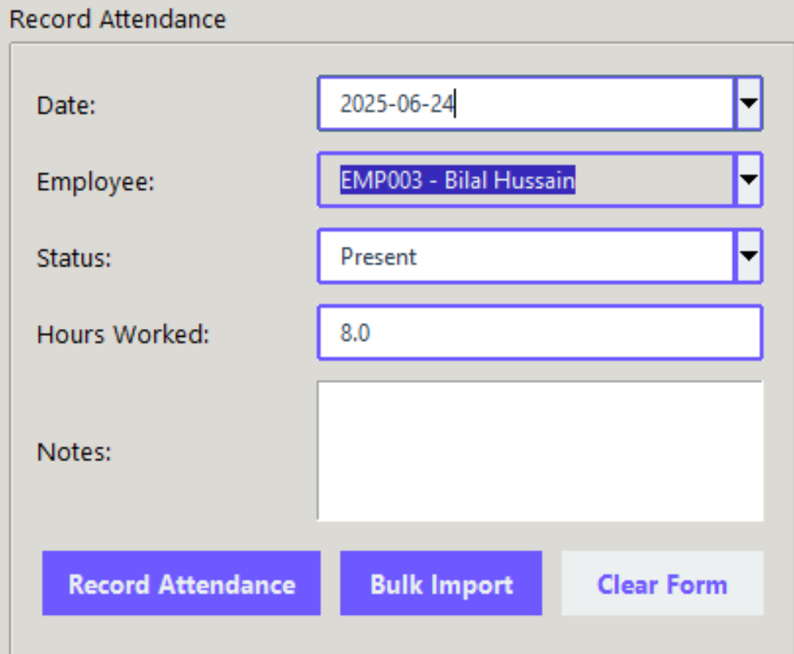
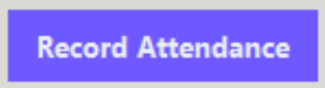
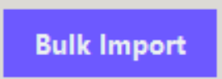
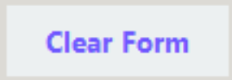
Record Attendance
Fill in the attendance form by selecting the employee, date, status, and hours worked.
Then click the "Record Attendance" button to save that employee’s attendance for the selected date.
Use the "Bulk Import" button to upload a file containing multiple attendance records.
This lets you add attendance data for many employees all at once, saving time.
Click the "Clear Form" button to instantly reset all attendance form fields, allowing you to enter new data without manually clearing the previous entry.

Slide 21
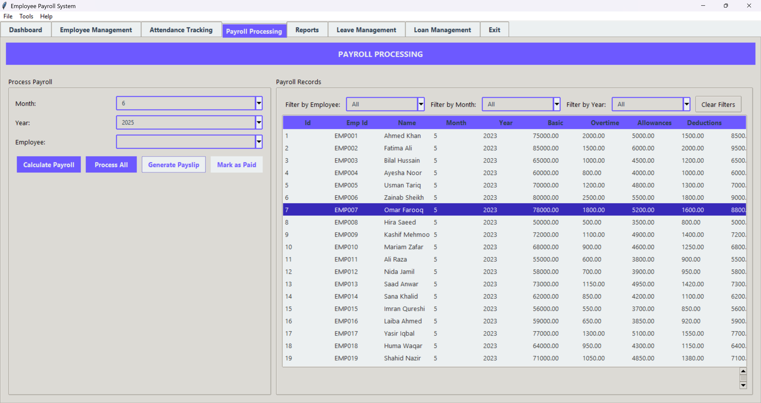
Payroll Management Dashboard

Slide 22
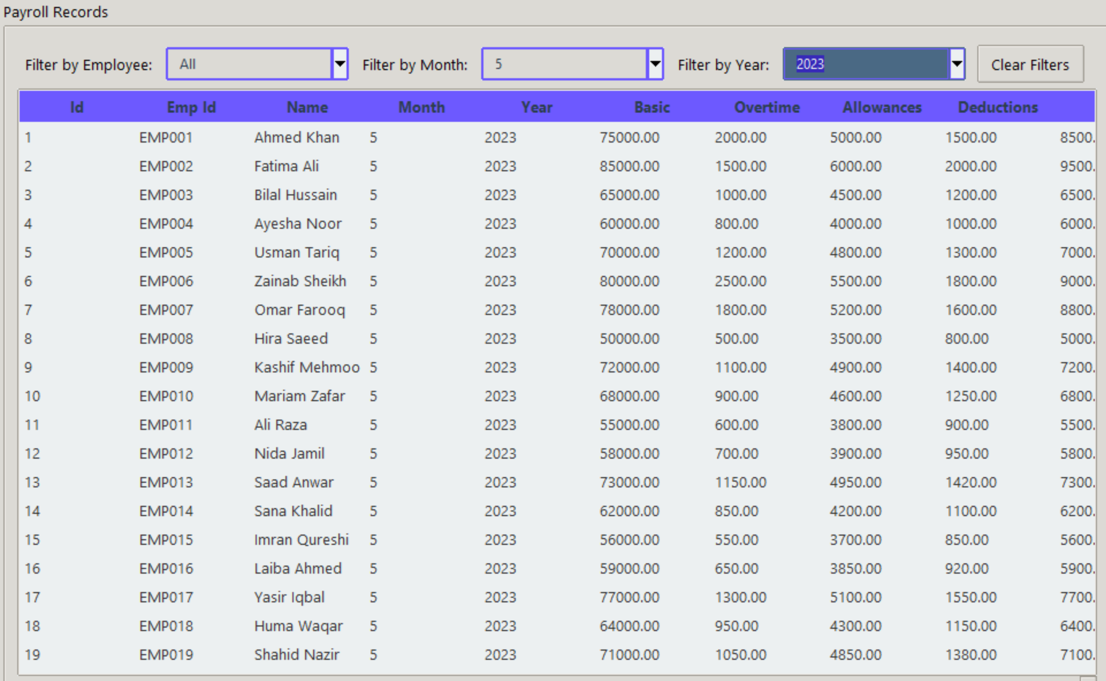
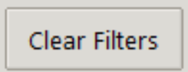
Search Payroll
You can search by filtering employee, month or year.
Just select employee, month or year it will automatically fetch all the data.
Click the "Clear Form" button to instantly reset all filters, allowing you to select new data without manually clearing the previous entry.

Slide 23
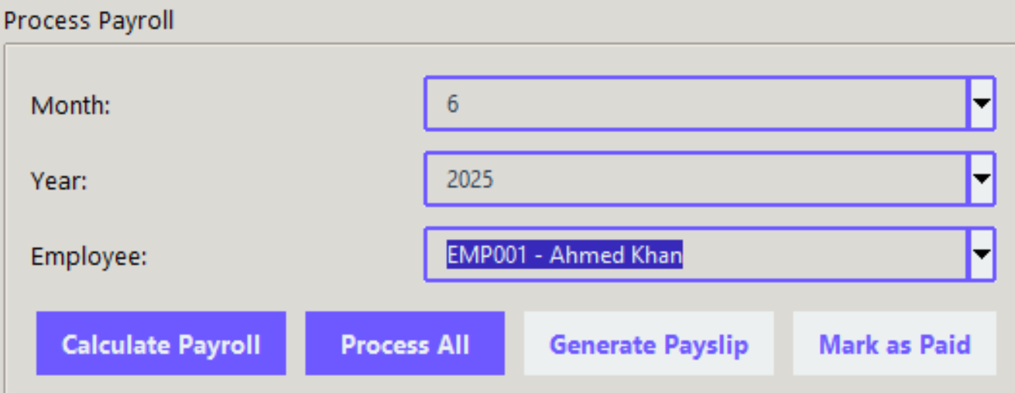
Calculate Payroll
Click the "Process All" button to automatically calculate and save payroll for all employees for the selected month and year in one go.
Select an employee, month, and year.
then click the "Calculate Payroll" button to compute their salary based on attendance, deductions, bonuses, and tax.
Use the "Mark as Paid" button to update the status of a payroll record, confirming that the salary has been disbursed to the employee.

Slide 24
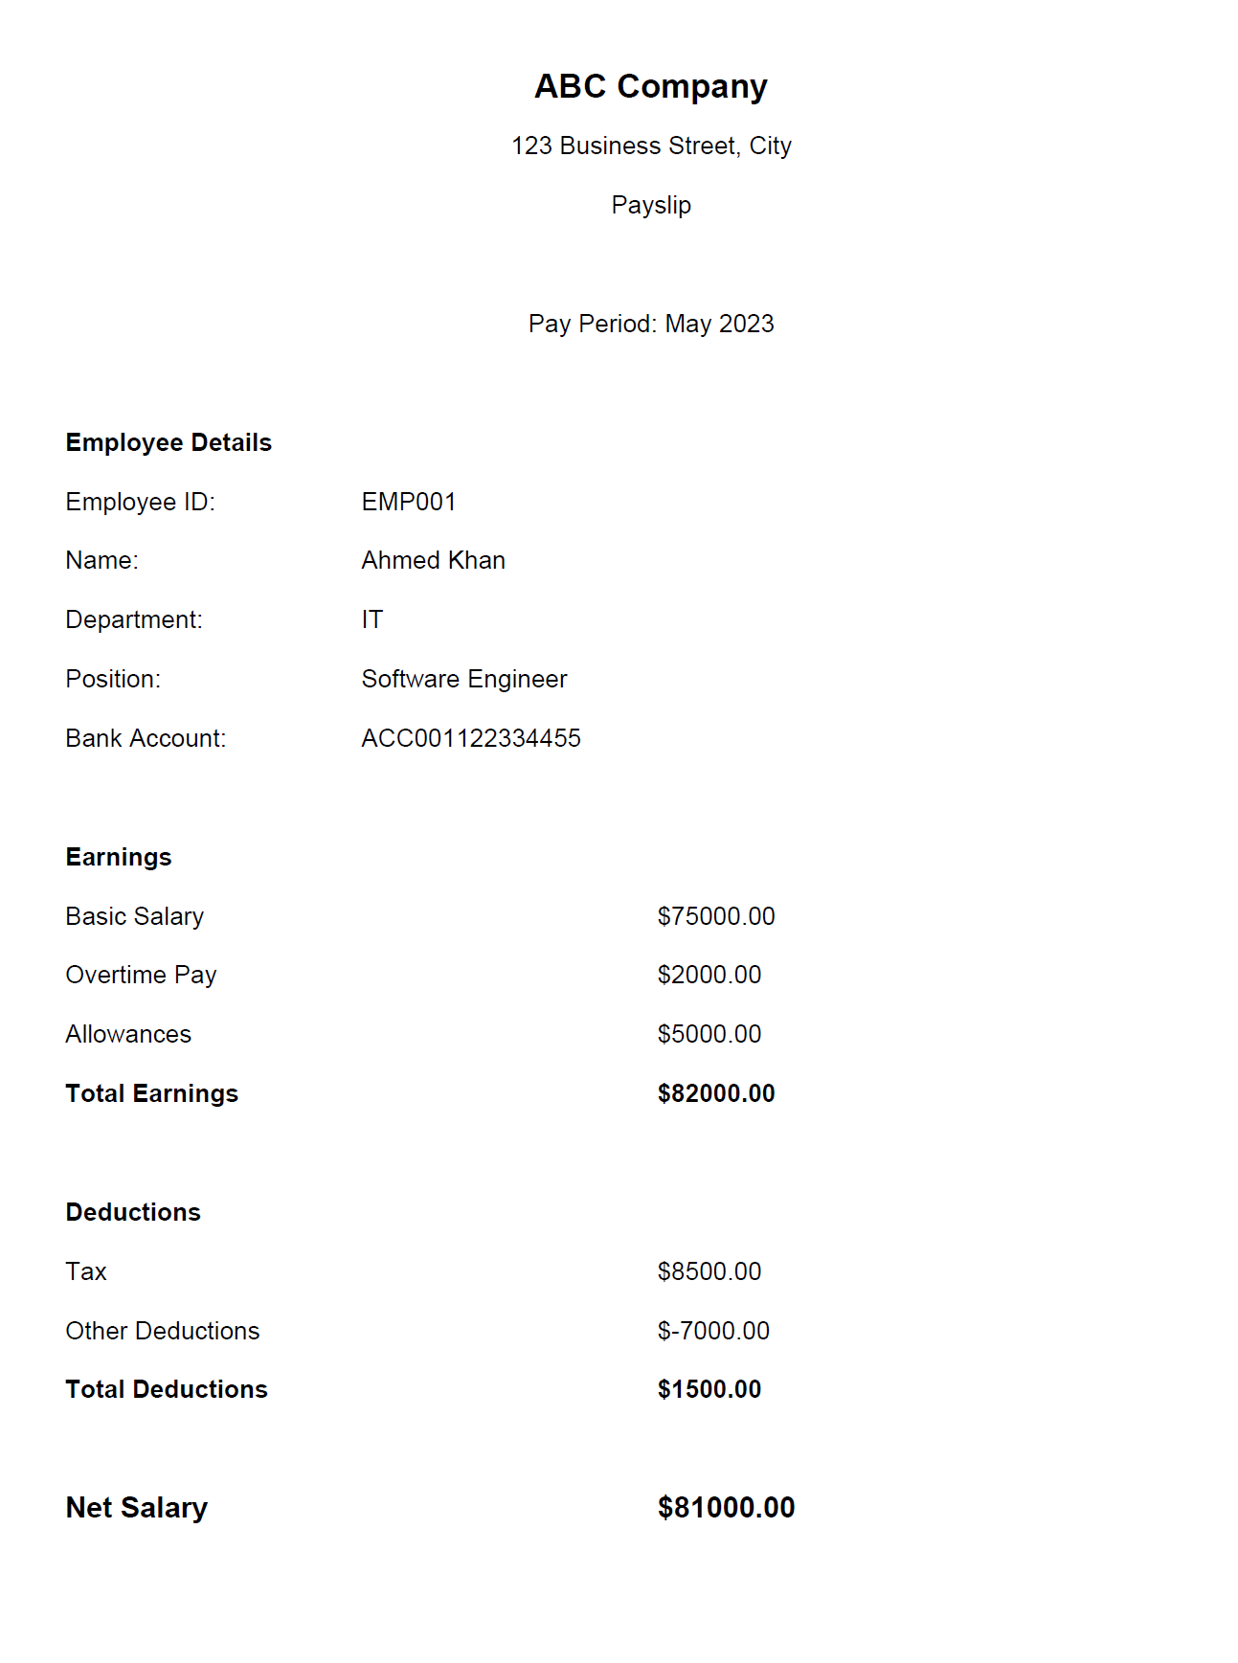
Generate Payroll
After processing payroll, click the "Generate Payslip" button to create a PDF payslip for the selected employee, which can be downloaded or printed.

Slide 25
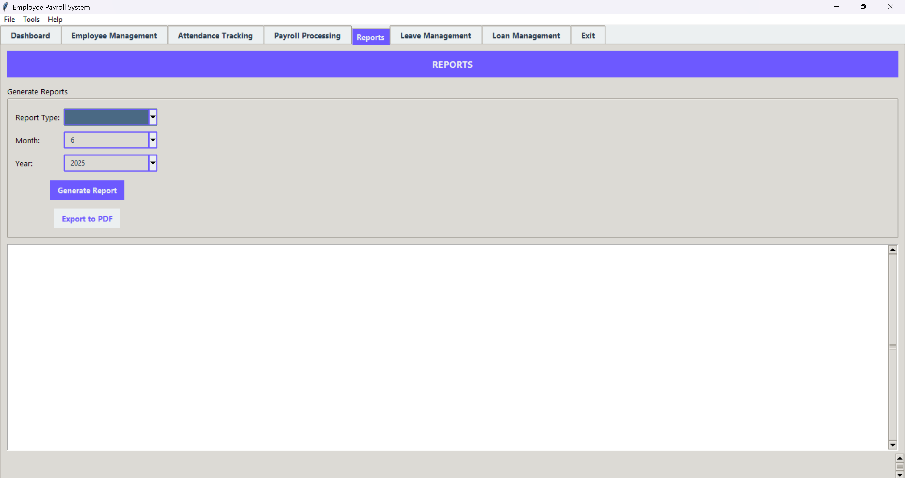
Report Management Dashboard

Slide 26
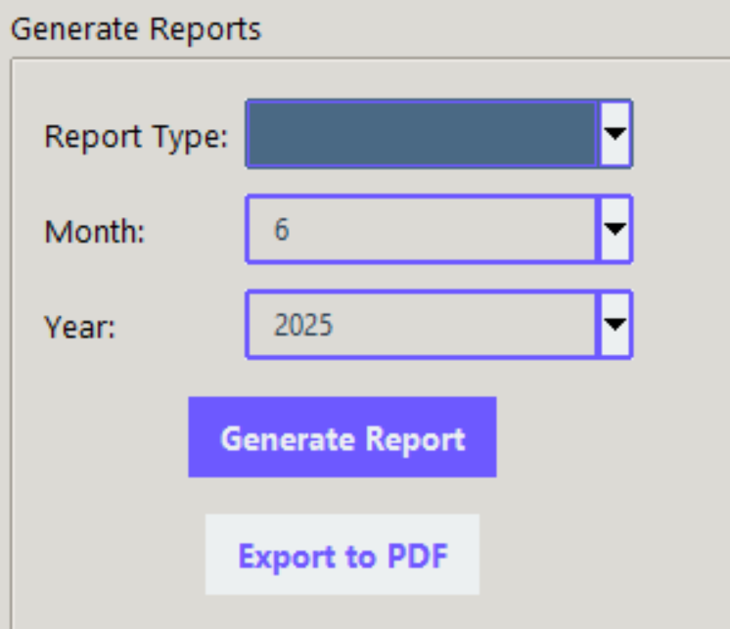
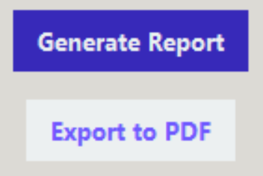
Generate Report
Select the type of report, month, and year.
Then click the "Generate Report" button to view detailed payroll summaries, attendance records, or tax reports directly within the application.
After generating a report, click the "Export to PDF" button to download the displayed report as a professionally formatted PDF file for printing or sharing.

Slide 27
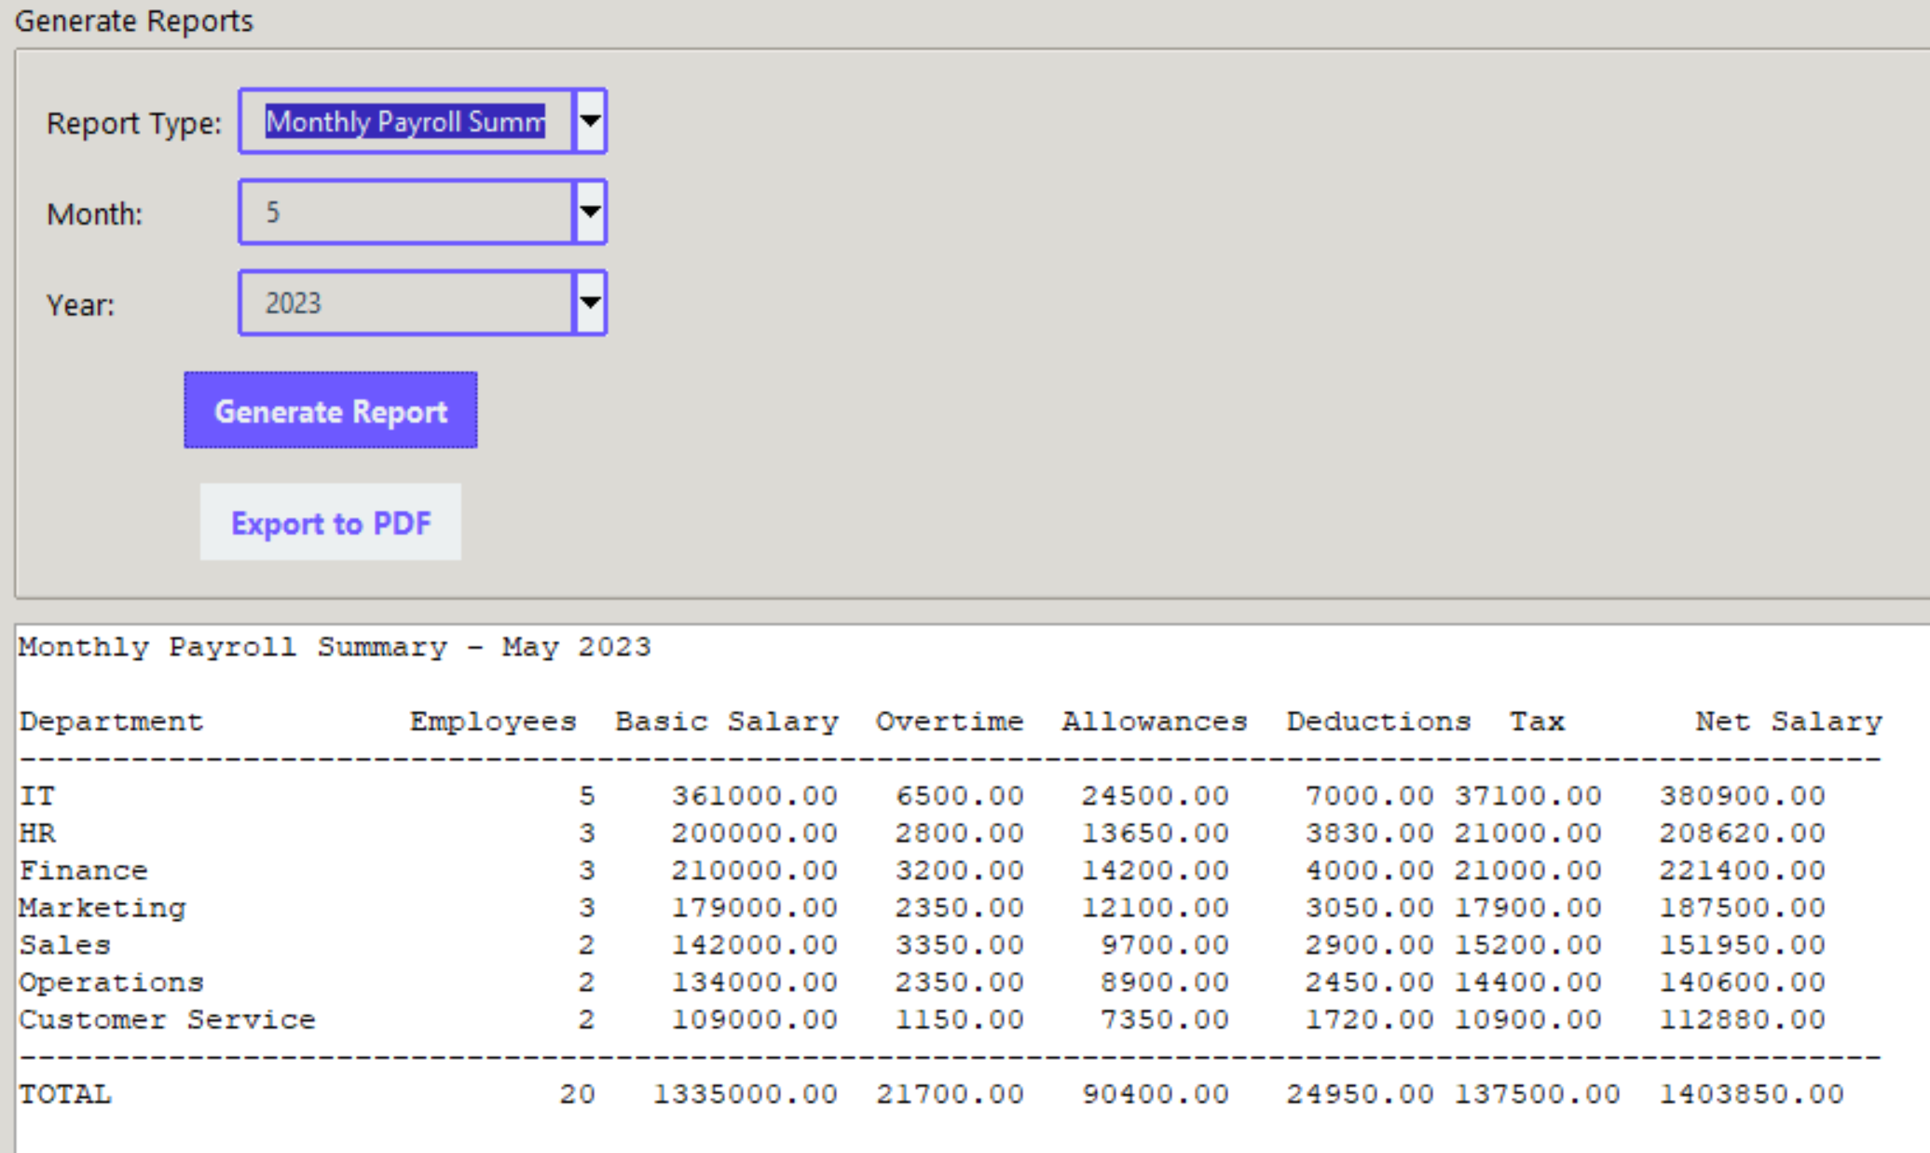
Monthly Payroll Summary
After generating a report, click the "Export to PDF" button to download the displayed report as a professionally formatted PDF file for printing or sharing.

Slide 28
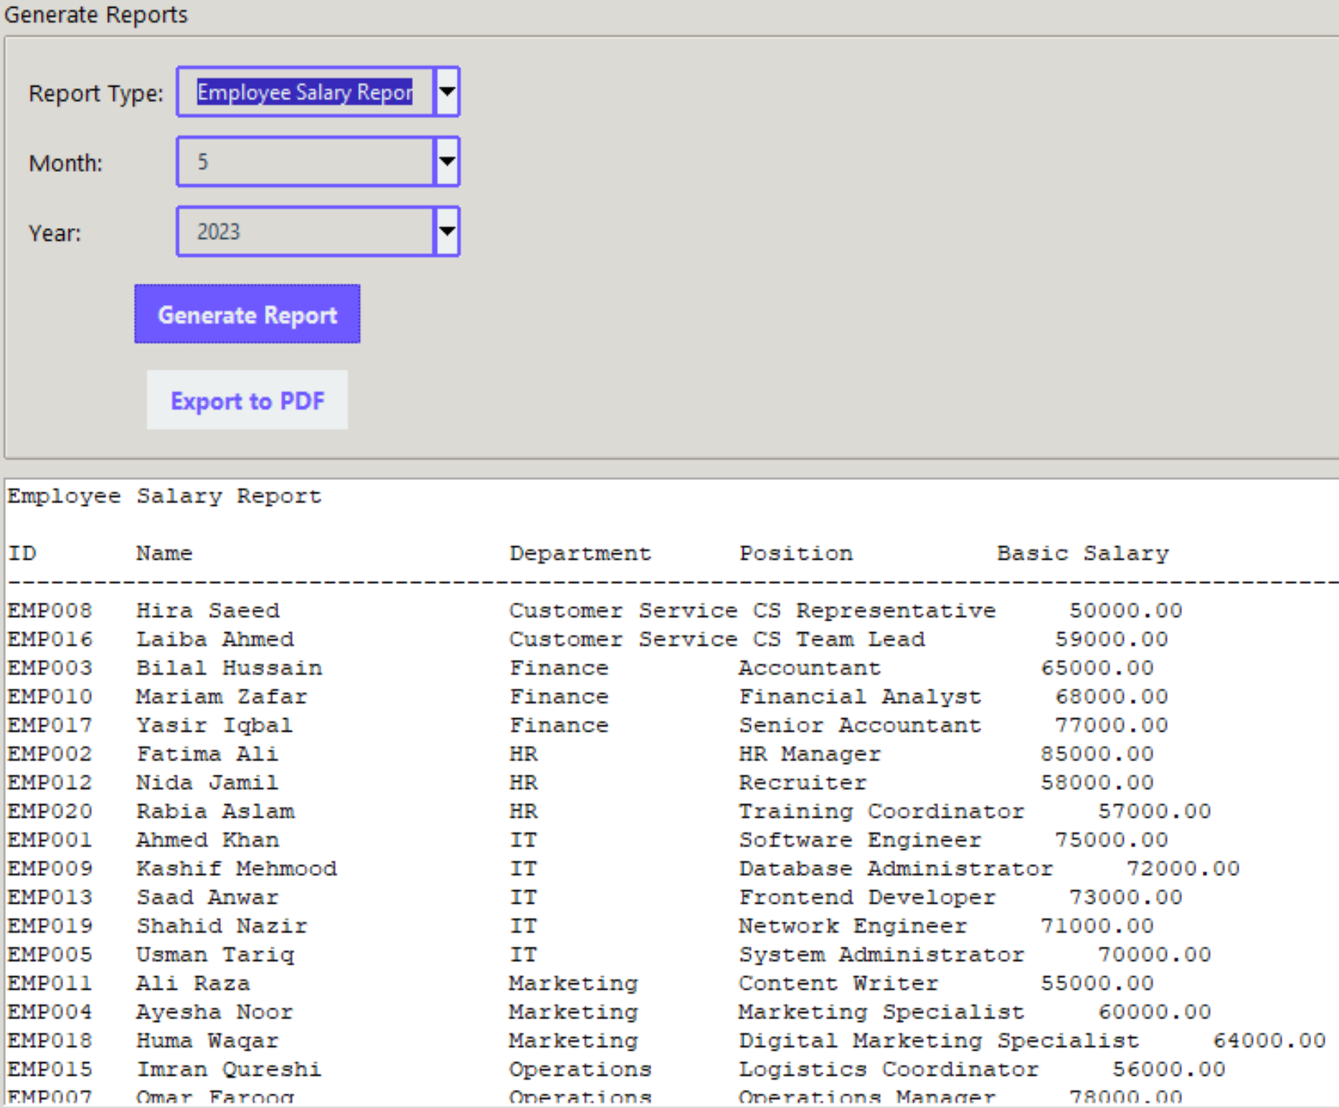
Employee salary Report
After generating a report, click the "Export to PDF" button to download the displayed report as a professionally formatted PDF file for printing or sharing.

Slide 29
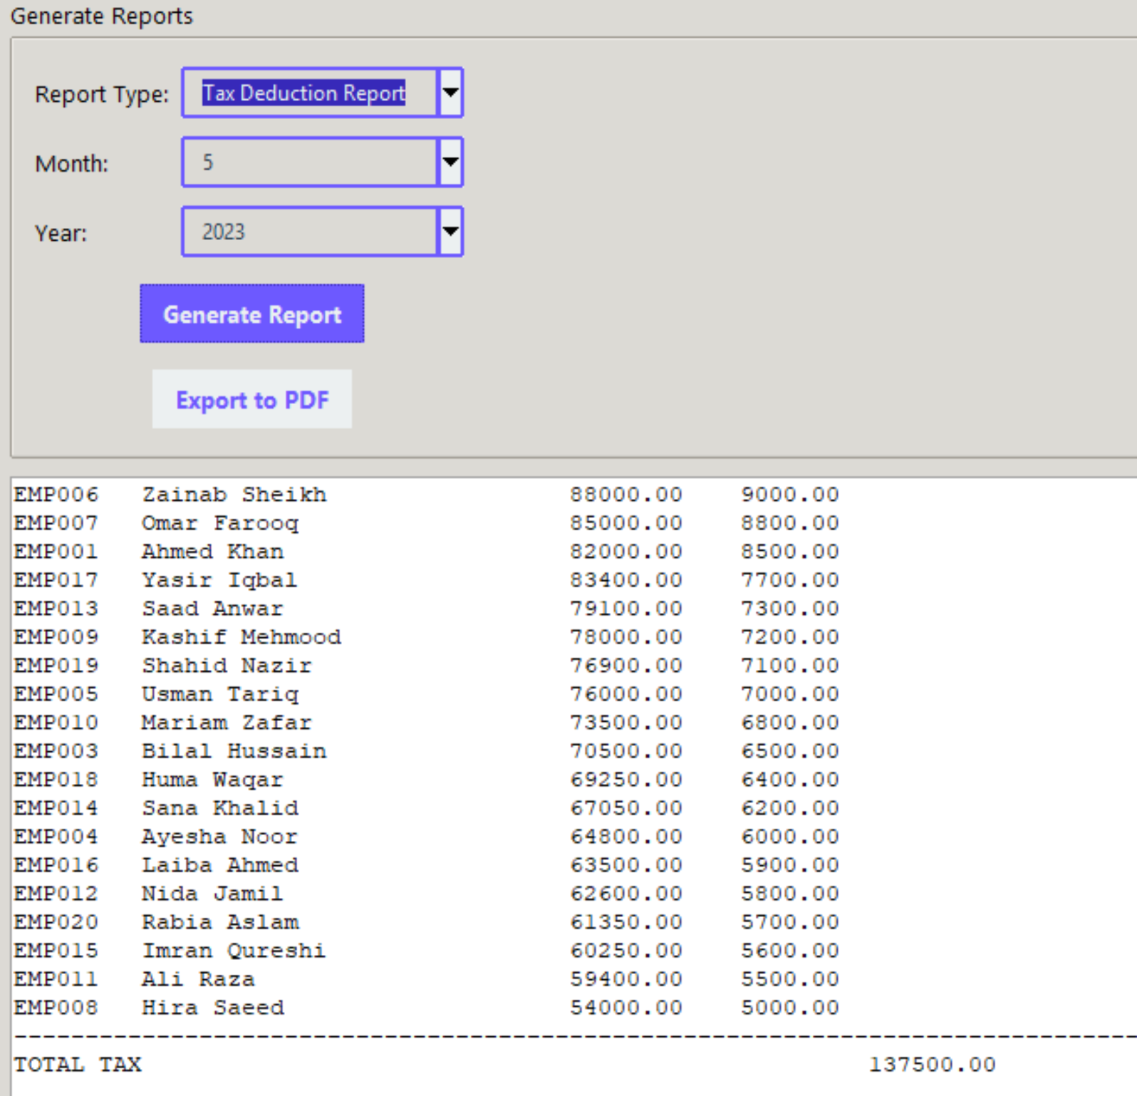
Tax Deduction Report
After generating a report, click the "Export to PDF" button to download the displayed report as a professionally formatted PDF file for printing or sharing.

Slide 30
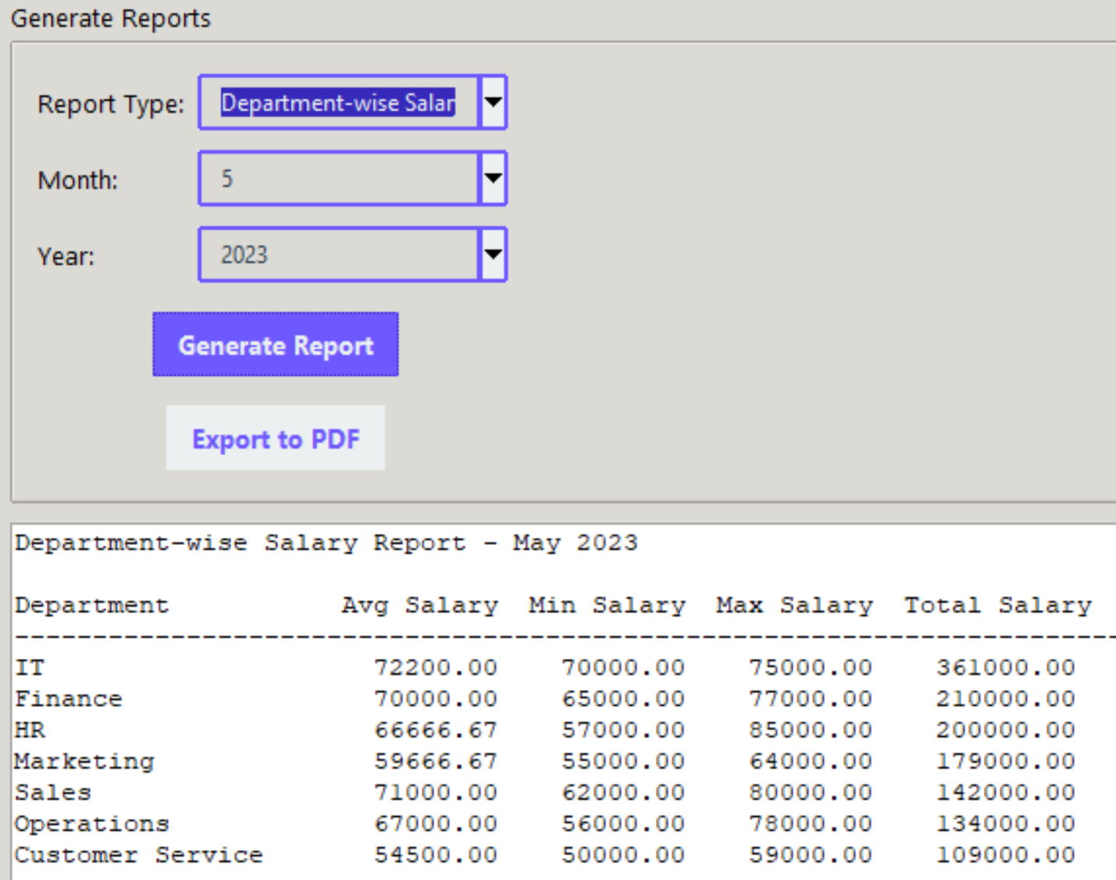
Department Wise Salary Report
After generating a report, click the "Export to PDF" button to download the displayed report as a professionally formatted PDF file for printing or sharing.

Slide 31
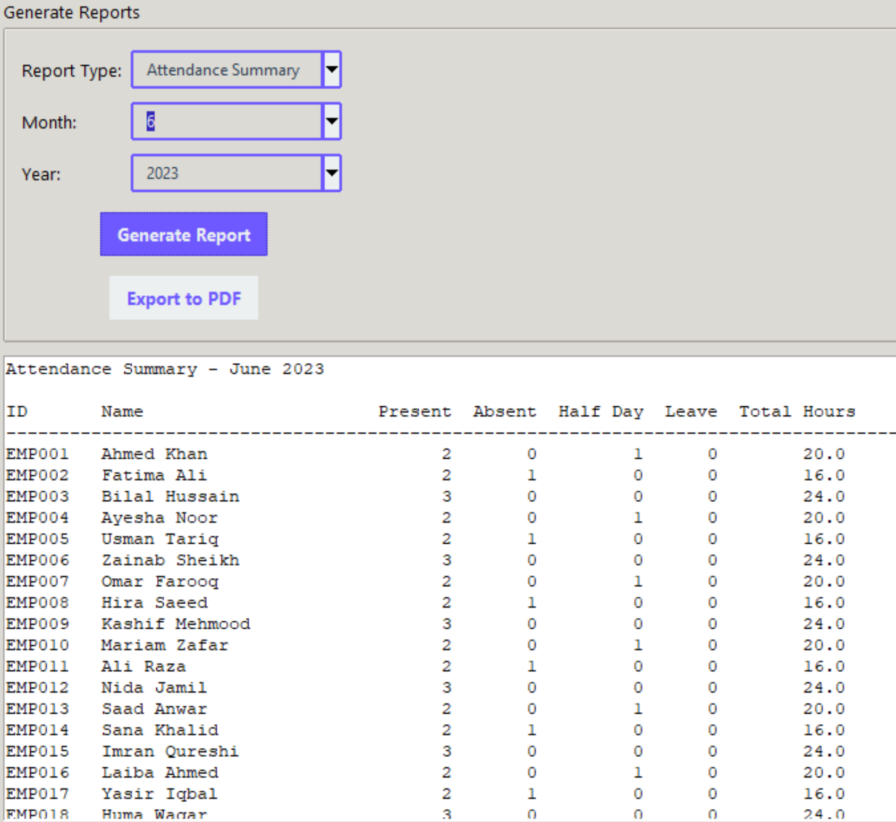
Attendance Summary
After generating a report, click the "Export to PDF" button to download the displayed report as a professionally formatted PDF file for printing or sharing.

Slide 32
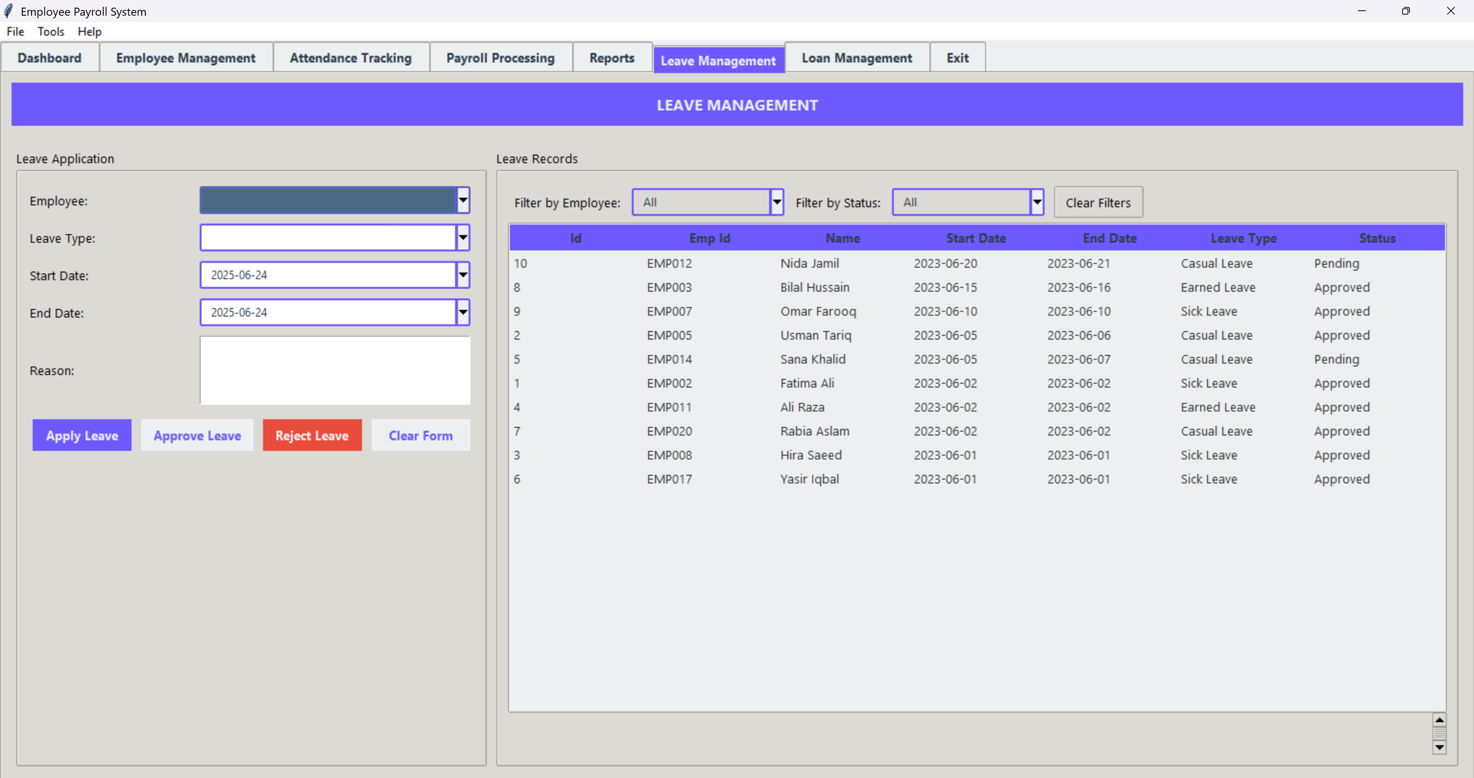
Leave Management Dashboard

Slide 33
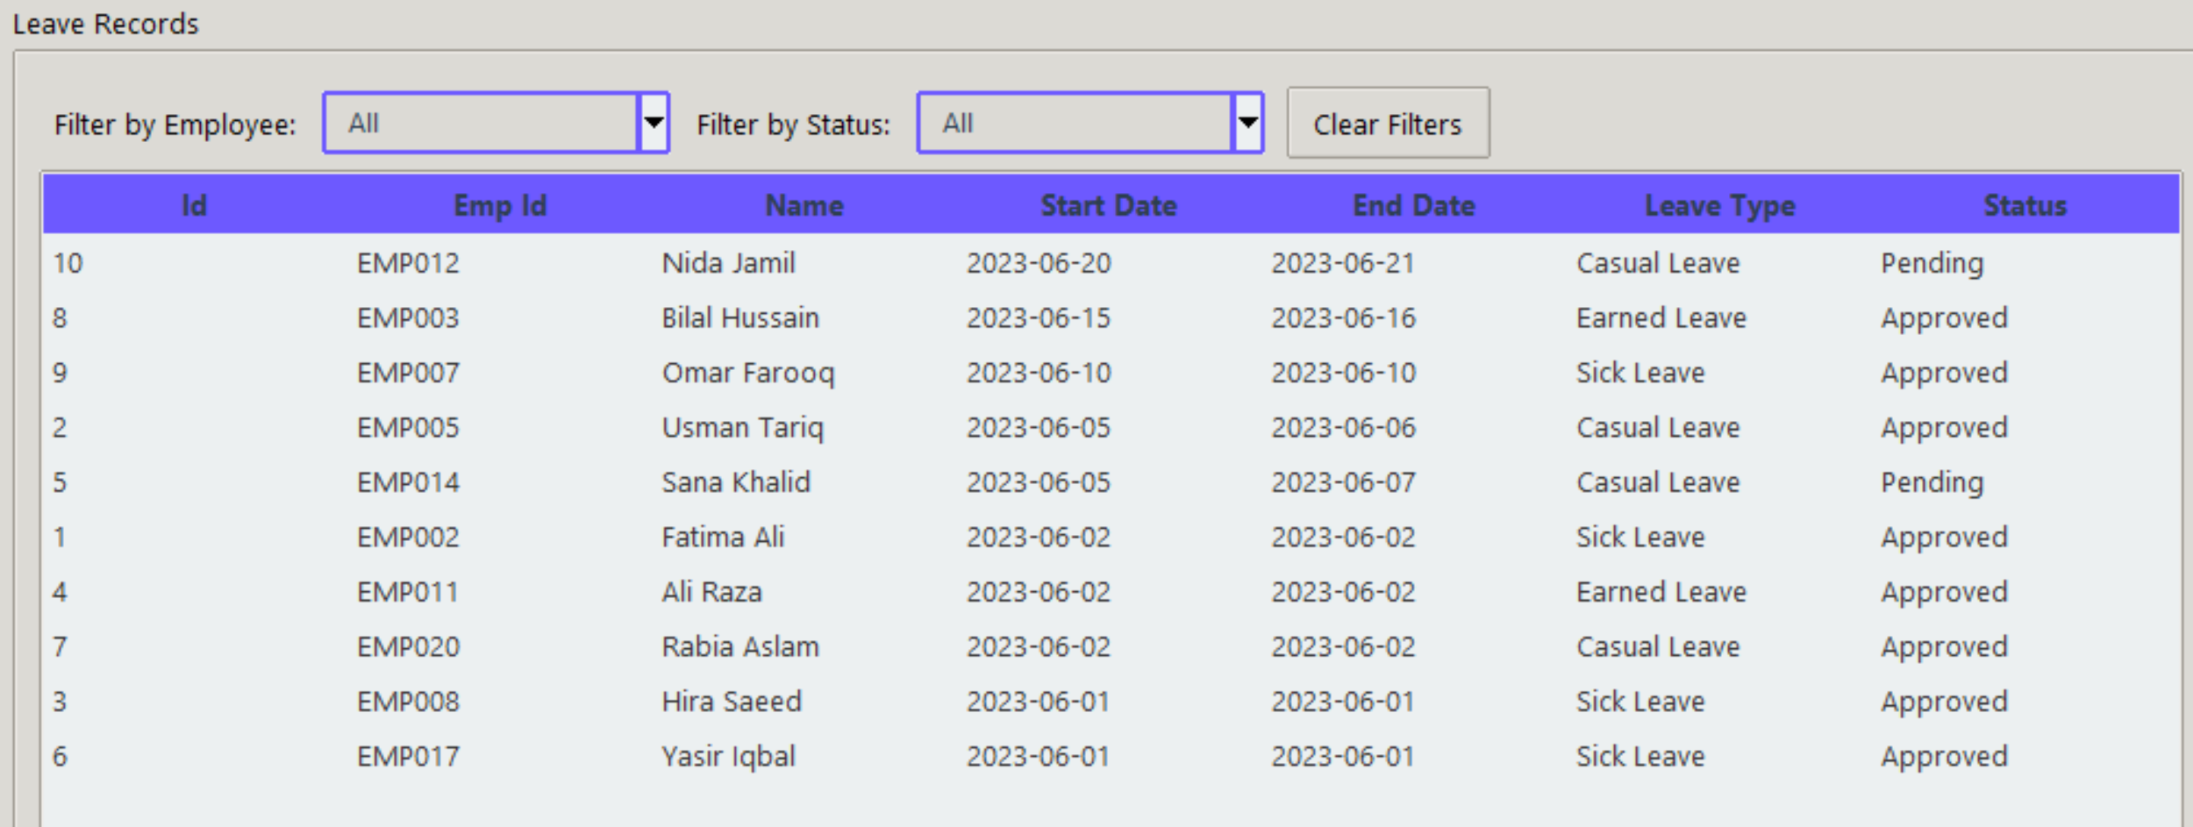
Search Employee Leaves
You can search by filtering employee, or Status.
Just select employee or Status and it will automatically fetch all the data.
Click the "Clear Form" button to instantly reset all filters, allowing you to select new data without manually clearing the previous entry.

Slide 34
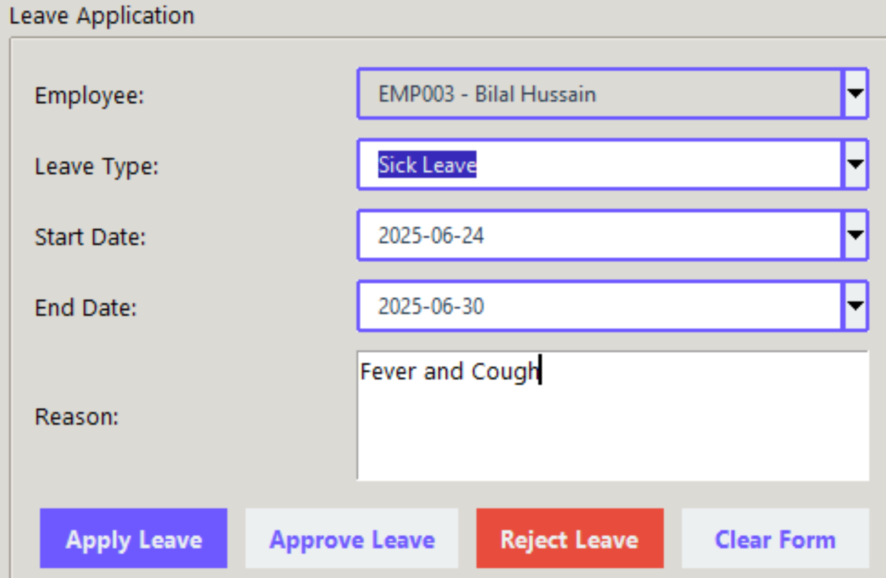
Manage Employee Leaves
Fill out the leave form by selecting the employee, leave type, start and end dates, and reason. Then click the "Apply Leave" button to submit the leave request.
To approve a pending leave request, select it from the leave records table and click the "Approve Leave" button. The status will update to "Approved."
To decline a leave request, select it from the list and click the "Reject Leave" button. The status will be changed to "Rejected."
Click the "Clear Form" button to reset all fields in the leave application form, making it ready for a new entry.

Slide 35
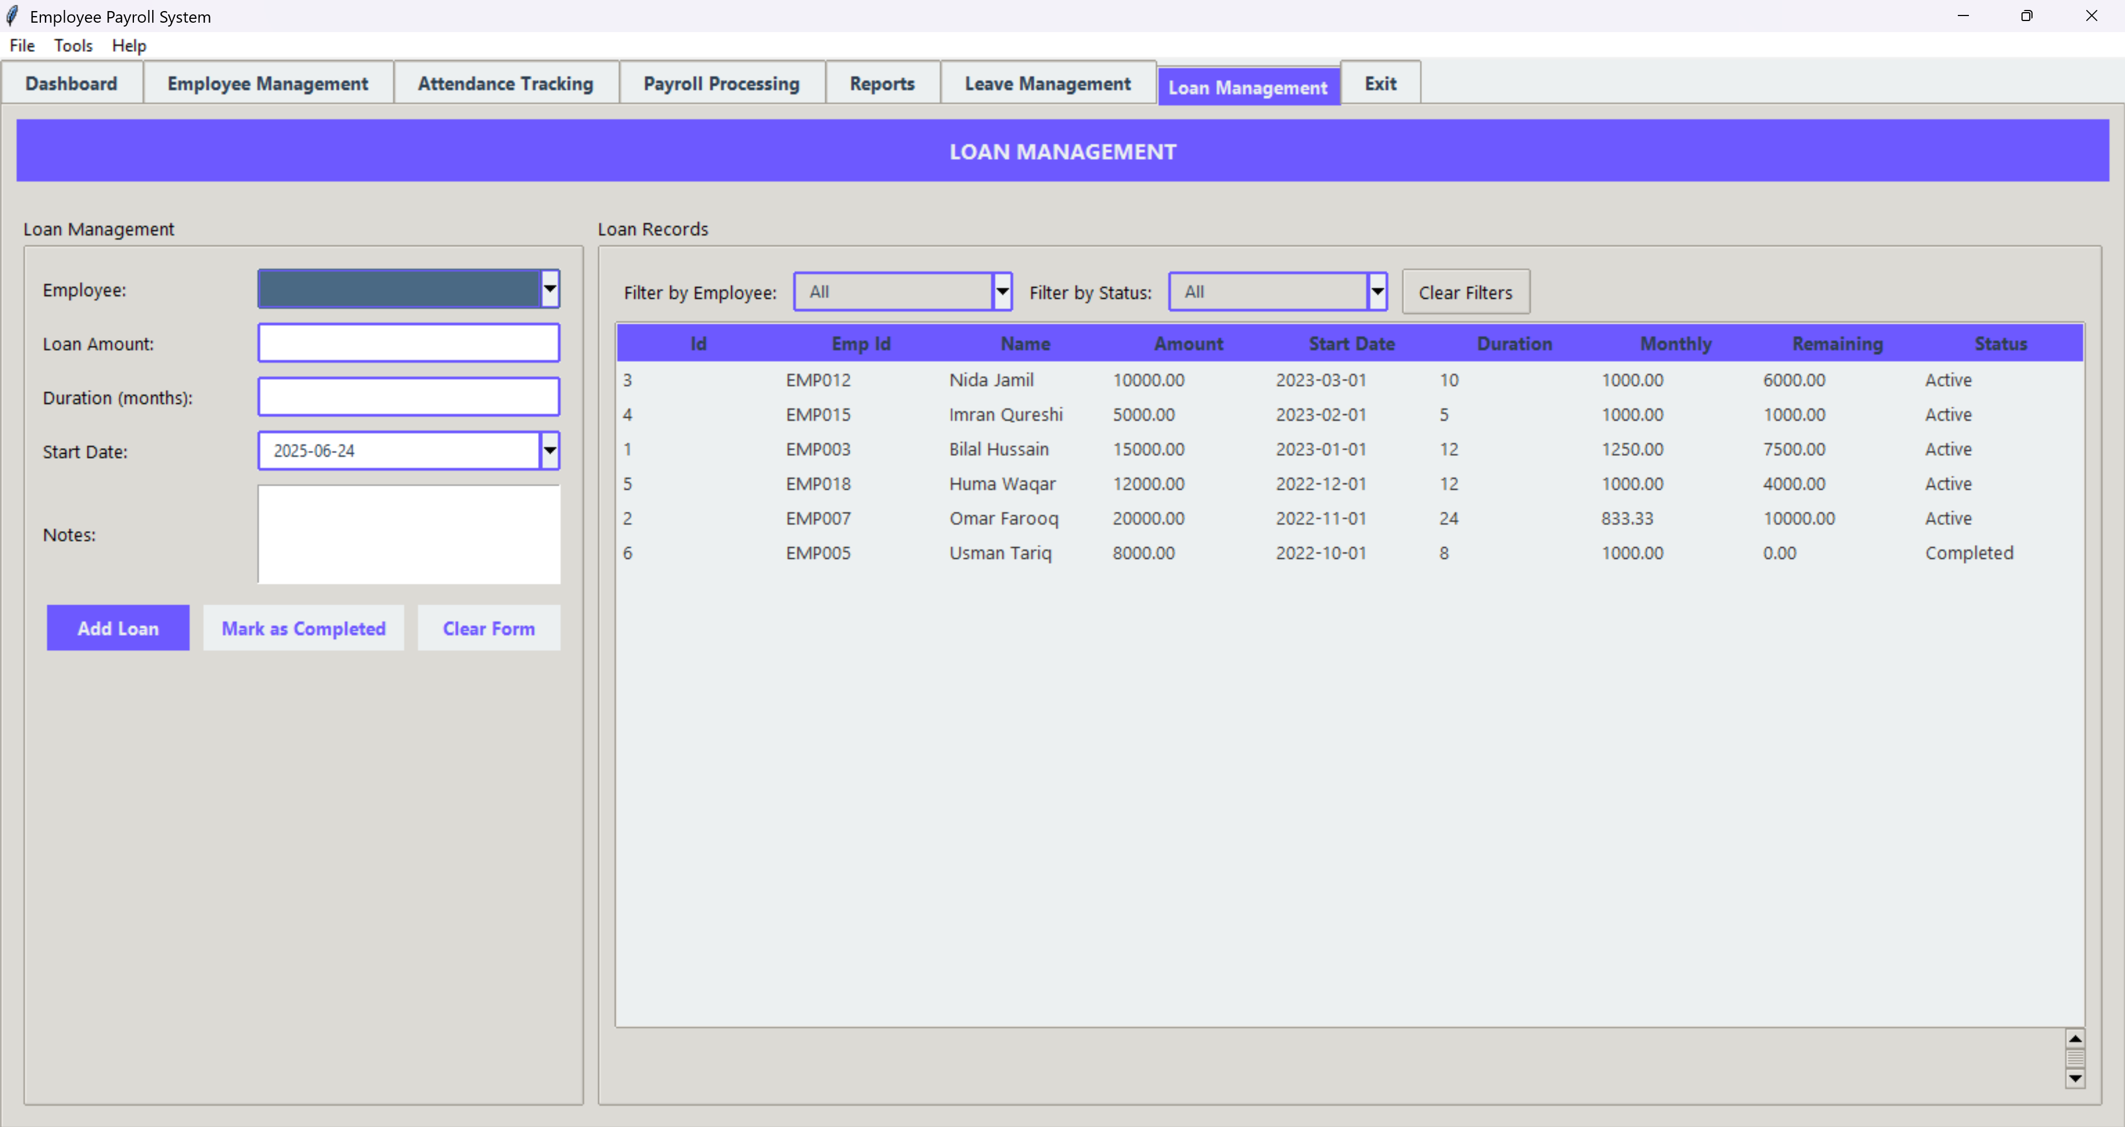
Loan Management Dashboard

Slide 36
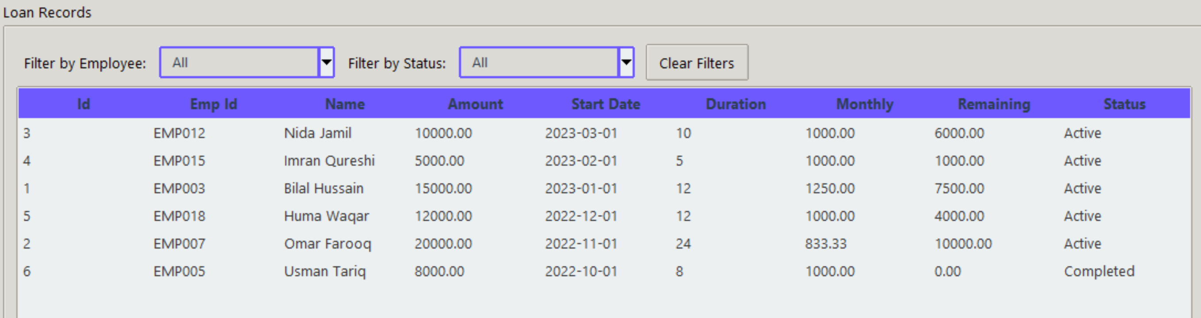
Loan Management Dashboard
You can search loan record by filtering employee, or Status.
Just select employee or Status and it will automatically fetch all the data.
Click the "Clear Form" button to instantly reset all filters, allowing you to select new data without manually clearing the previous entry.

Slide 37
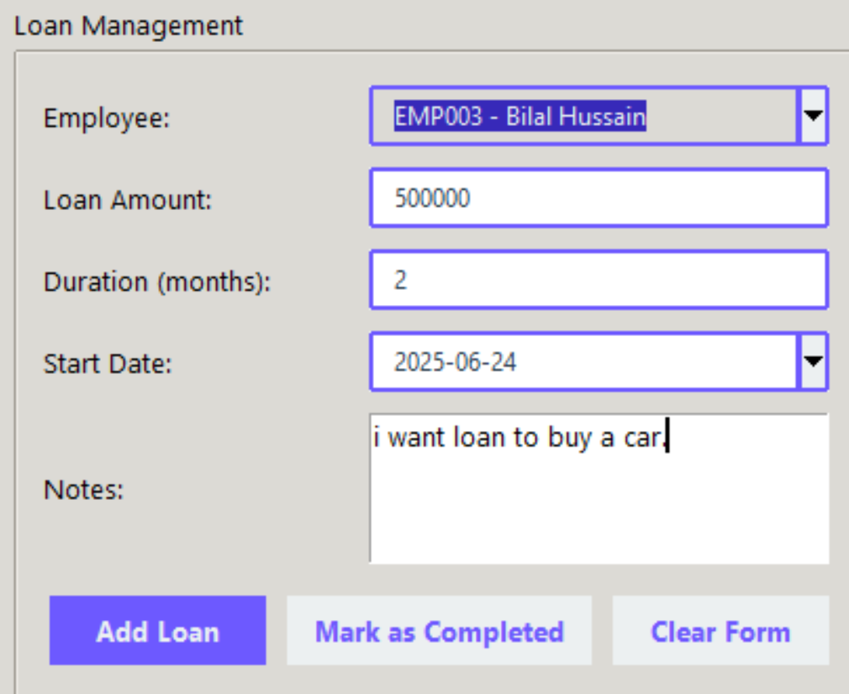
Loan Management Dashboard
Fill in the loan form with employee name, loan amount, duration, start date, and notes.
Then click the "Add Loan" button to save the loan request and start tracking repayments.
Once a loan has been fully repaid, select it from the loan records table.
click the "Mark as Completed" button to update its status.
Click the "Clear Form" button to reset all fields in the loan form, allowing you to enter a new loan request cleanly.

Slide 38
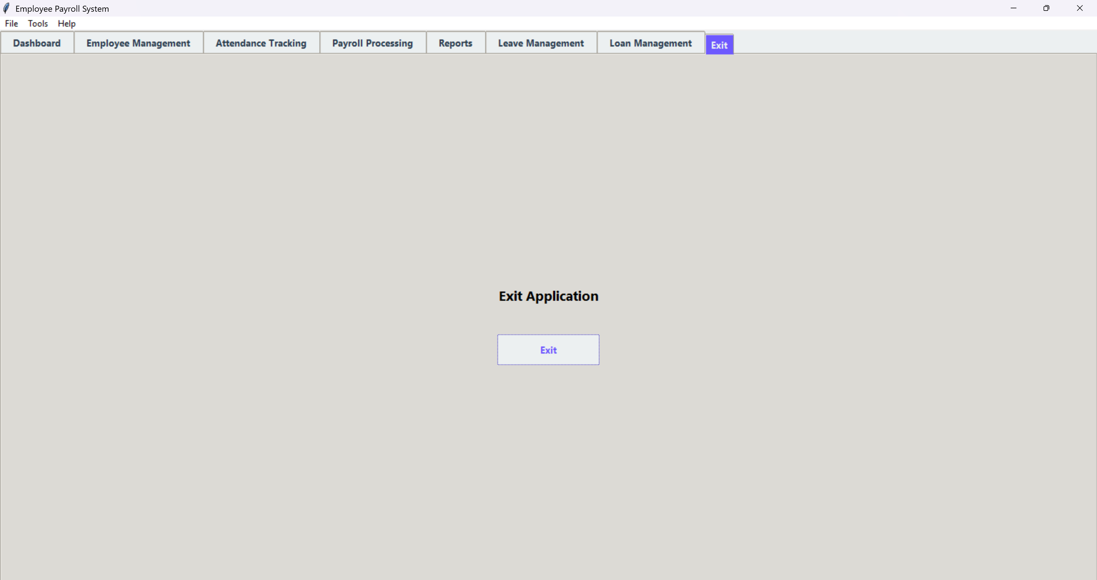

Exit
Click the "Exit" button in the Exit tab to safely close the application. This ends the session and shuts down the Payroll System.

Slide 39


File & Tools Menu
Click the "Export Data" option from the File menu to download or save system records (like employees, attendance, or payroll) in a readable file format for external use or reporting.
Select the "Exit" option from the File menu (or use the Exit tab) to safely close and terminate the application.
Choose the "Backup Database" option from the Tools menu to create a secure copy of the entire database. This ensures your data is saved and can be restored in case of system failure.
Click the "Restore Database" option to upload and recover a previously saved database backup, bringing the system back to an earlier state.

Slide 40



Help Menu
Click the "User Guide" option in the Help menu to open a step-by-step instruction manual or online documentation. It explains how to use each feature of the Payroll System effectively.
Select the "About" option to view information about the application, including its purpose, version, technologies used, and developer credits.

Slide 41

challenges
Ensuring accurate payroll calculations without human error.
Securing sensitive login and admin credentials.
Maintaining data consistency across modules (e.g., employee, payroll, attendance).
Designing a clean, intuitive, and user-friendly interface.
Reducing time spent on manual data entry for large employee sets.
Providing printable and professional reports/payslips.
Handling database backups and restoration securely.
Managing real-time feedback, validation, and error handling in forms.

Slide 42

Solutions
✅ Automated payroll calculations based on attendance, deductions, and tax formulas ✅ Secure login system using bcrypt for password hashing ✅ Synchronized data updates using relational database and foreign key constraints ✅ User-friendly interface built with Tkinter and organized tab layout ✅ Bulk Import feature to quickly upload multiple attendance records ✅ PDF generation using FPDF for reports and employee payslips ✅ Centralized database operations using reusable functions and classes ✅ Real-time validation and error handling for accurate data entry

Slide 43

Comparison chart

Slide 44
INFOGRAPHIC REPORT
Real World
Case Example
Future work
Improvements
Can be applied in companies, schools, hospitals, and agencies to manage staff and salary. Especially helpful for small businesses digitizing operations.
A local company saved 90% of payroll processing time by using a similar system. Accuracy improved and employee satisfaction increased.
Explore AI-based payroll forecasting, machine learning for attendance anomalies, or blockchain for secure payroll records.
Future versions can include biometric login, cloud sync, mobile access, automated tax filing, and integration with third-party HR tools.

Slide 45
INFOGRAPHIC REPORT
Summary
Key finding
importance
Ending line
This project automates employee management, attendance, payroll, leave, loans, and reporting using Python, Tkinter, and MySQL. It improves accuracy and efficiency by replacing manual processes with a centralized digital system.
Enhanced Accuracy
Improved-Efficiency
Robust Security
Real-Time Data
Integration
User-Friendly-Interface
The project addresses real HR challenges like delays and errors. My role was to design, develop, and integrate all core modules, ensuring security, usability, and proper database connectivity.
Automation is no longer optional—it's essential. This system shows how technology can simplify payroll management and free up time for more valuable work.

Slide 46

Any Question..?

Slide 47
Thank you

